Slide 1
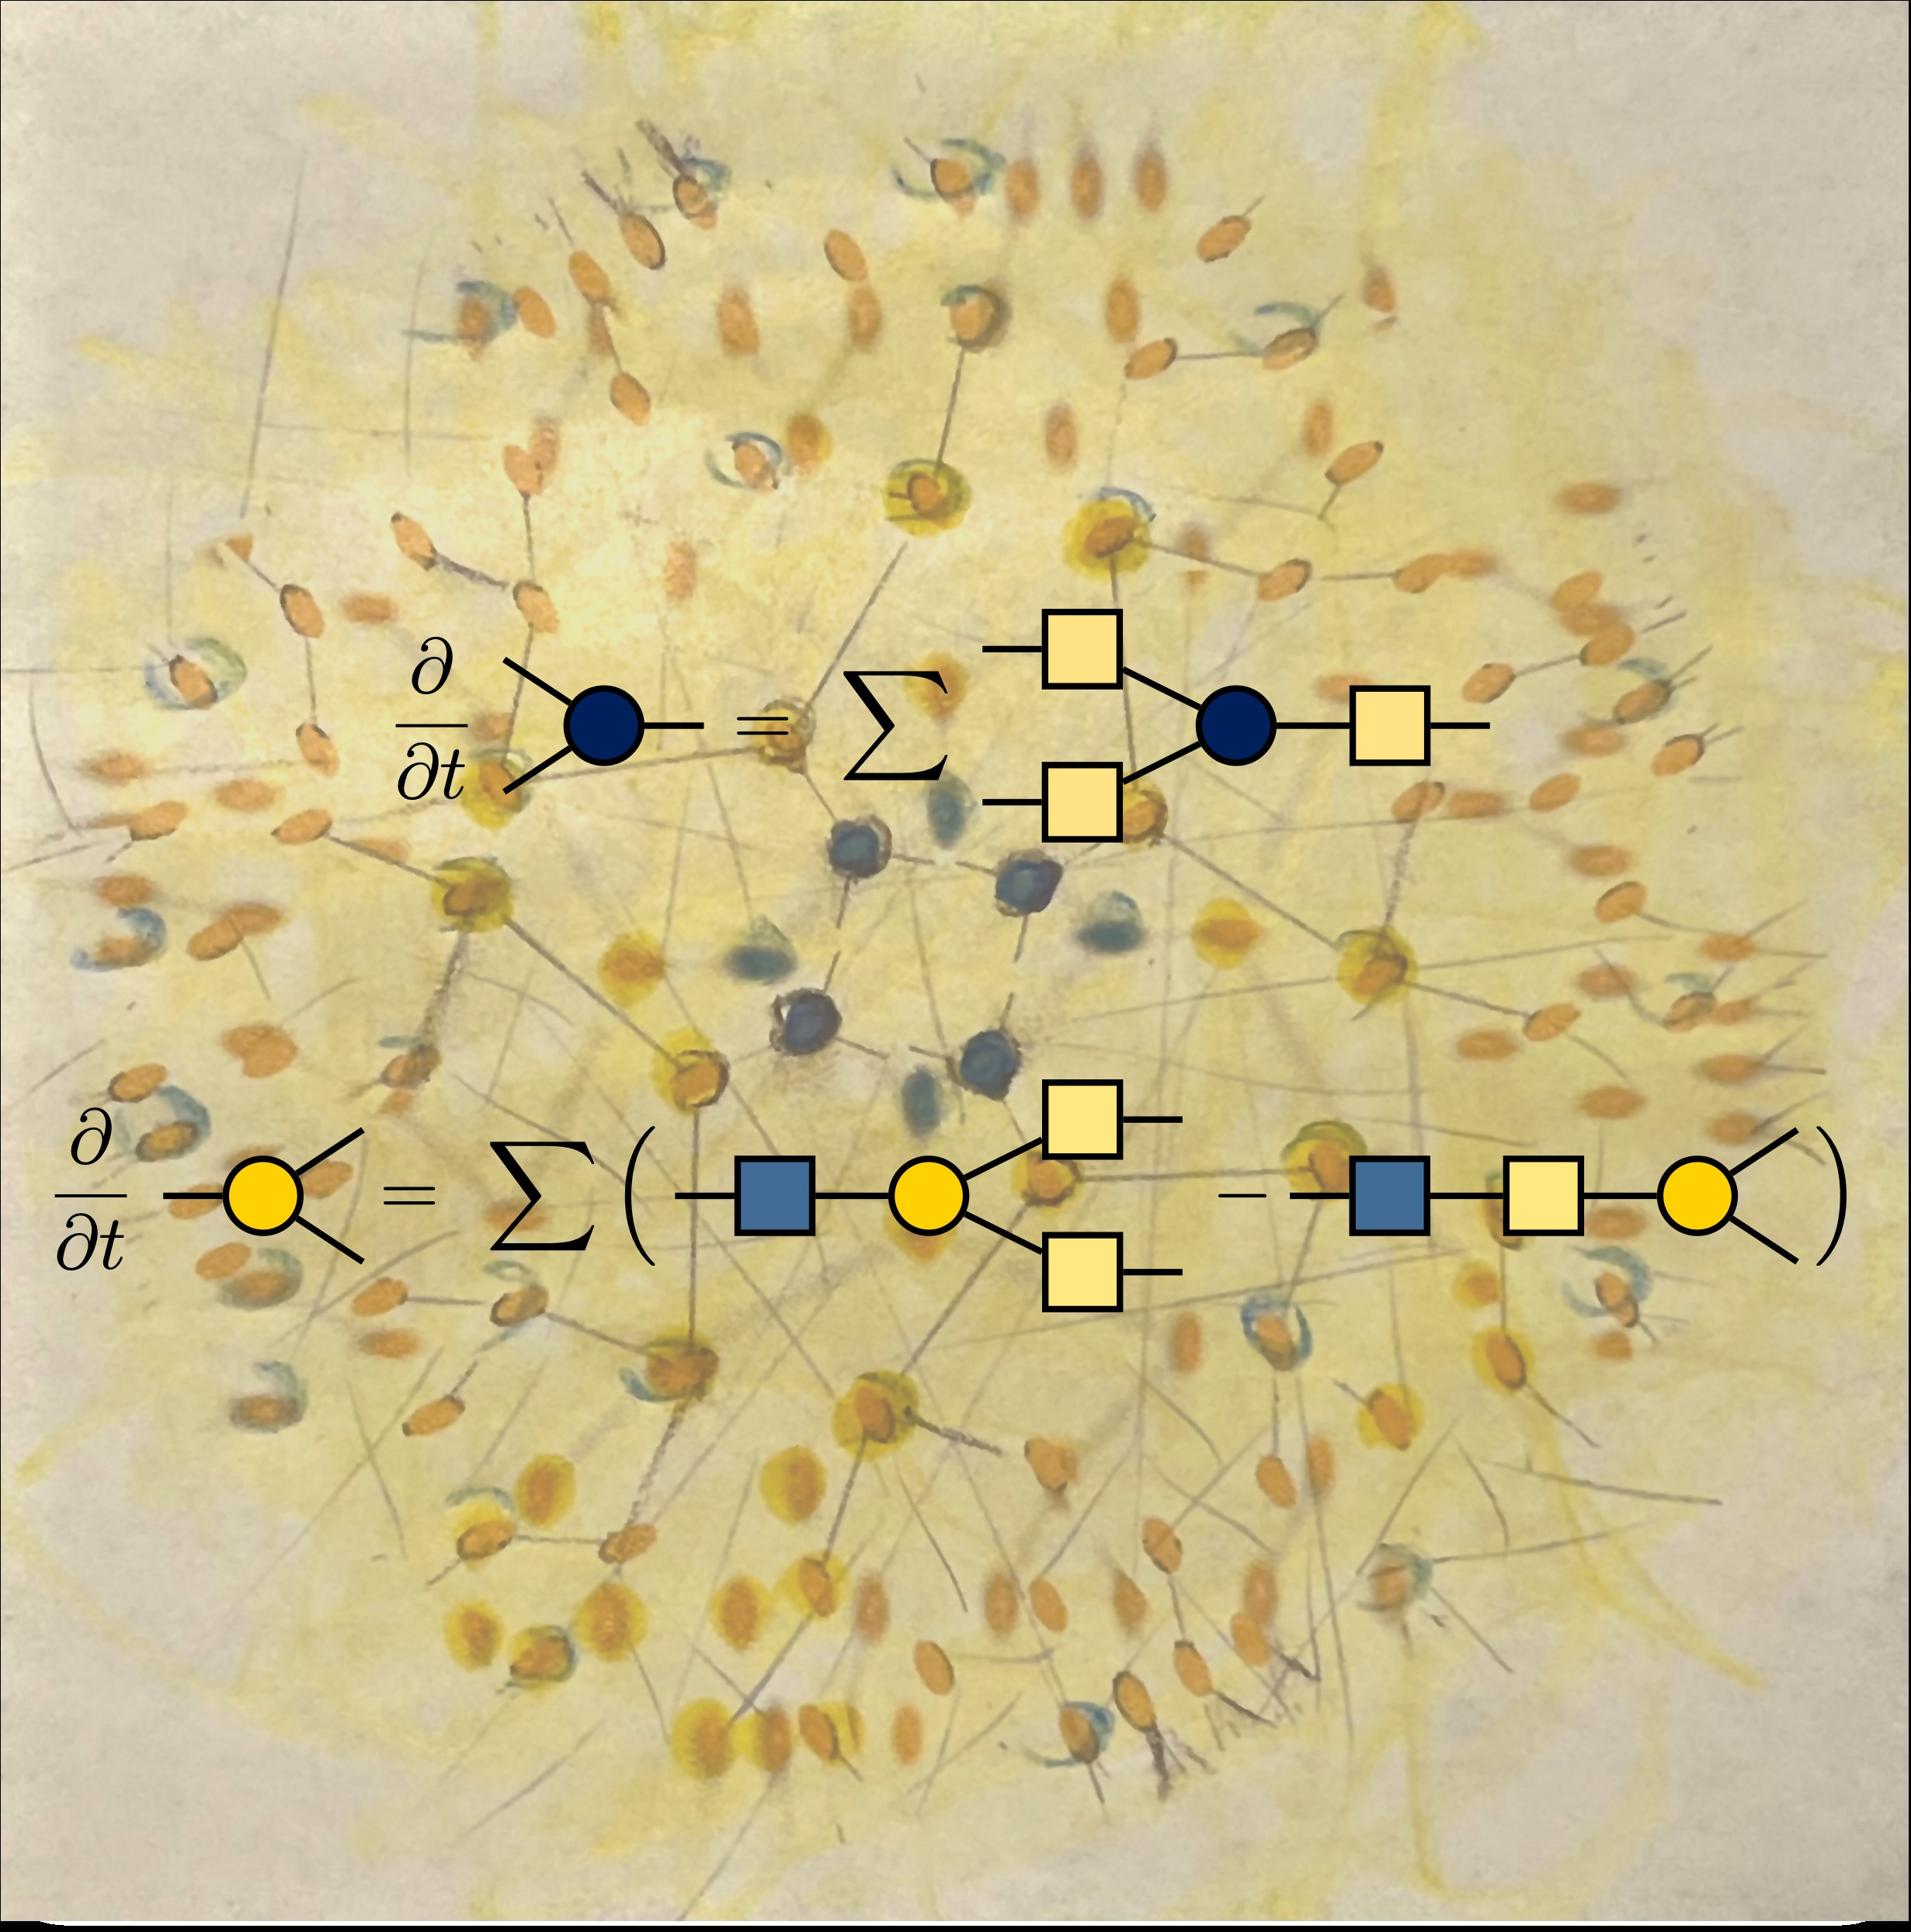
TENSO: Tree Tensor Network Equations for Non-Markovian Open Quantum Systems
Ignacio Franco
January 7, 2026
University of Rochester
Texas Quantum Winter School
@annylafont

Slide 2
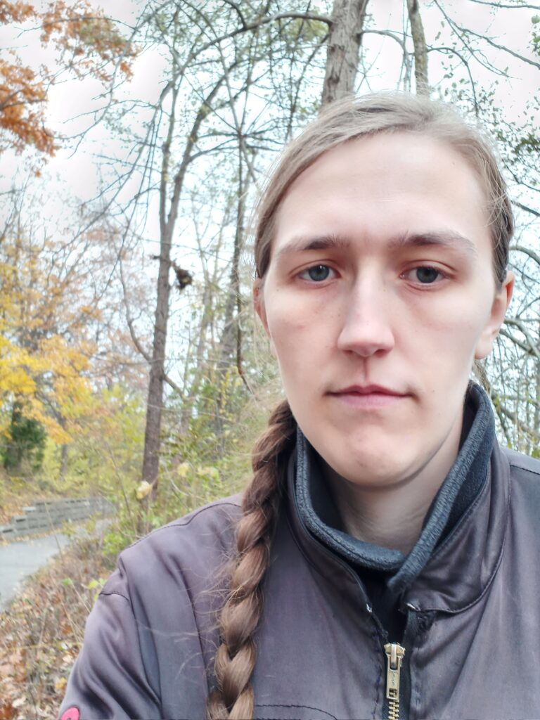
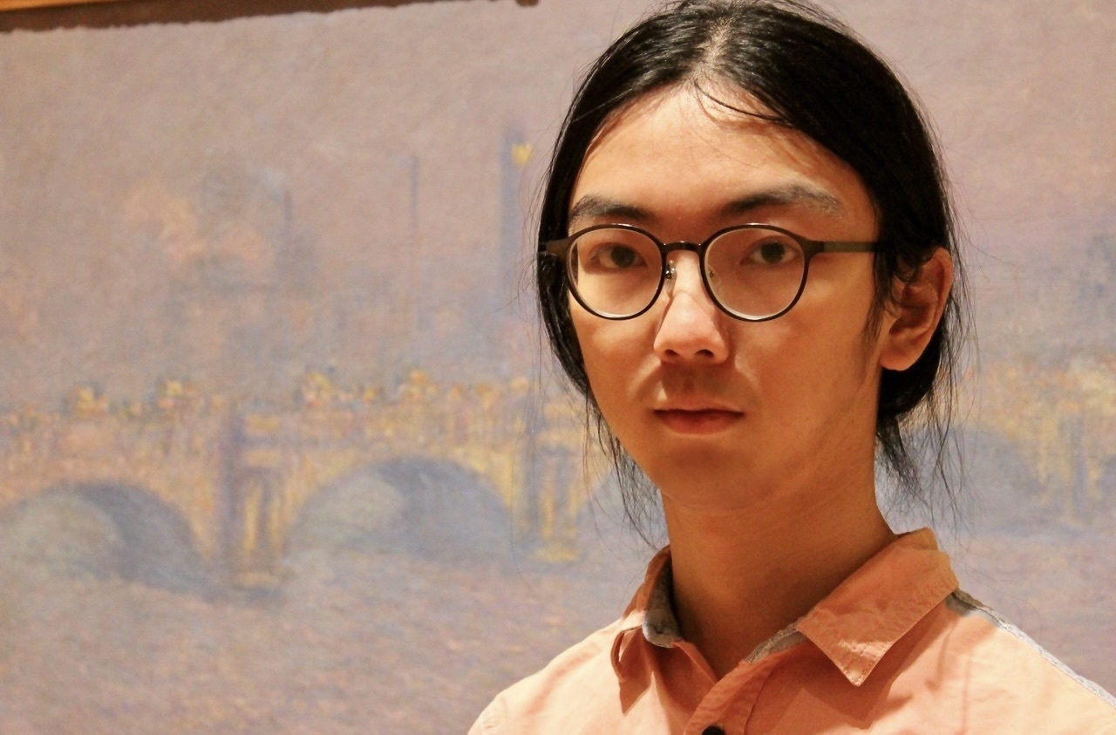

Thanks!
Juan Camilo Rodríguez, Michelle Anderson, Luchang Niu
Examples, Usage, Documentation
Xinxian Chen
Bexcitonic HEOM, TTN-HEOM, TENSO, Examples
Developed a big segment of this tutorial!
Notes:
Rossky-Prezhdo-Bittner

Slide 3
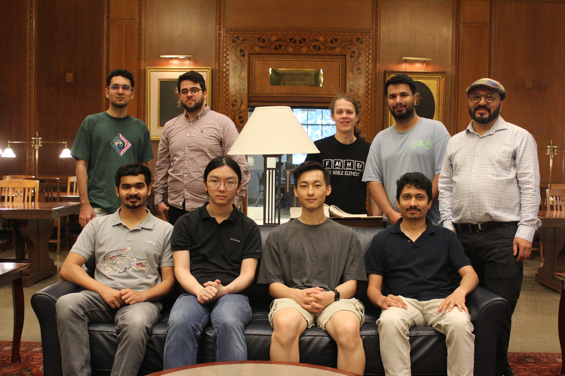
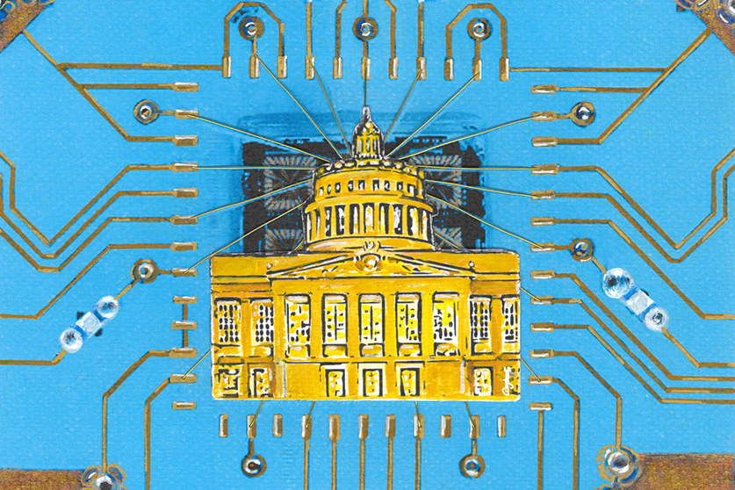
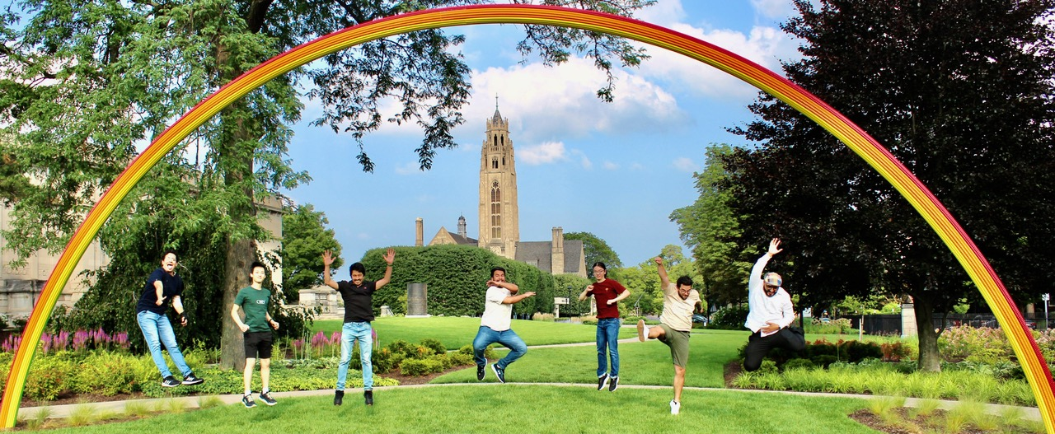


Thanks!
UR Center for Coherence and Quantum Science
DOE DE-SC0025334
NSF CHE-2416048
NSF CHE-2511834
NSF PHYS-2310657
NSF CHE-1553939

Slide 4
The Hierarchical Equation of Motion (HEOM)
System agnostic
Admits driven systems
Numerically exact for harmonic environments
Admits non-commuting system-bath interactions
Goes beyond Lindblad/Redfield Markovian models
Memory hungry
Computational cost scales exponentially with size of system and complexity of the environment
Ishizaki and Tanimura, JCP 125 084501 (2006)
Tanaka and Tanimura, JCP 132 214502 (2010)
Tanimura JCP 141 044114 (2014)
Ikeda and Scholes, JCP, 152, 204101 (2020)
Tanimura, JCP 153, 020901 (2020)
Yan, Xu, Li, and Shi, JCP 154, 194104 (2021)
Chen and Franco, JCP 160, 204116 (2024)
Notes:
Rossky-Prezhdo-Bittner

Slide 5
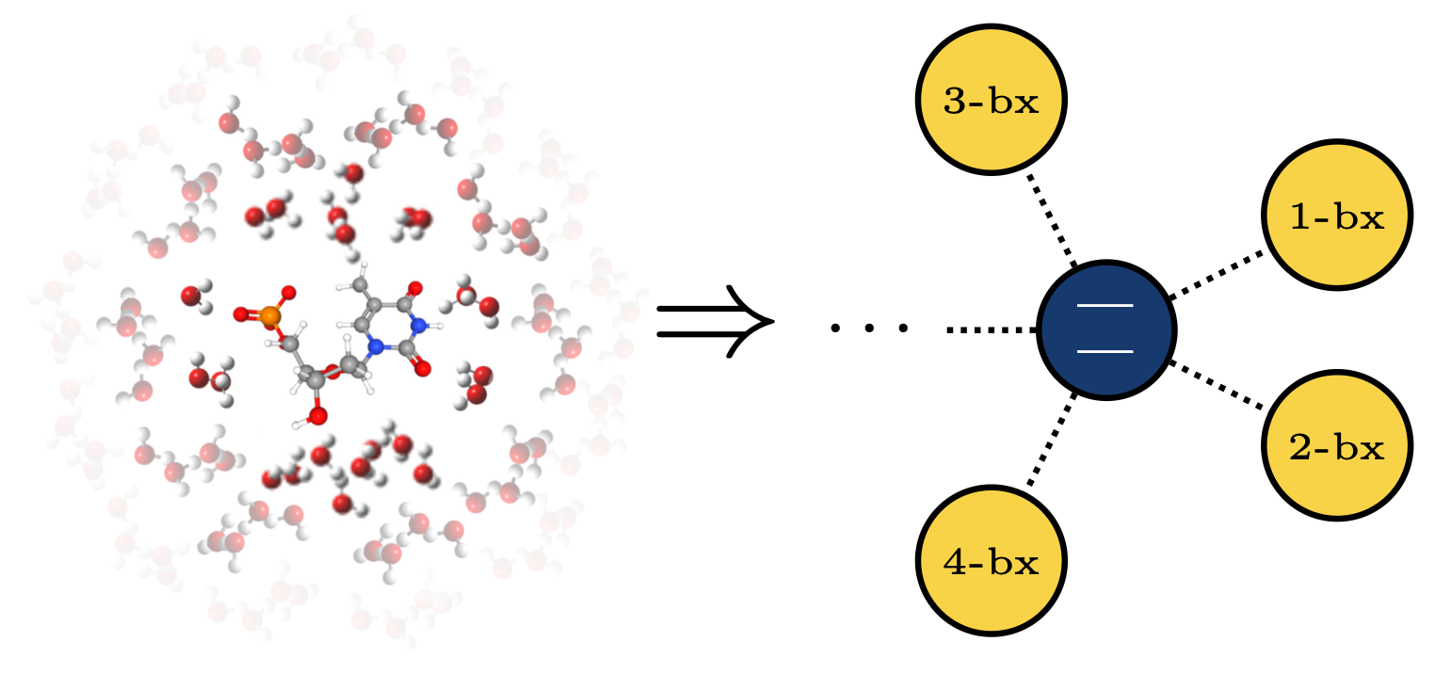
Bexcitonic generalization of HEOM
X. Chen and I. Franco, J. Chem. Phys. 160, 204116 (2024)
Open Quantum Dynamics = Dynamics of the System + Bexcitons
Depth of HEOM N = Number of bexcitonic levels
Includes all HEOM variants
Notes:
Rossky-Prezhdo-Bittner

Slide 6
The curse of dimensionality in HEOM
Memory needs grow exponentially with number of features
Realistic spectral density
Model spectral density
Notes:
Rossky-Prezhdo-Bittner

Slide 7

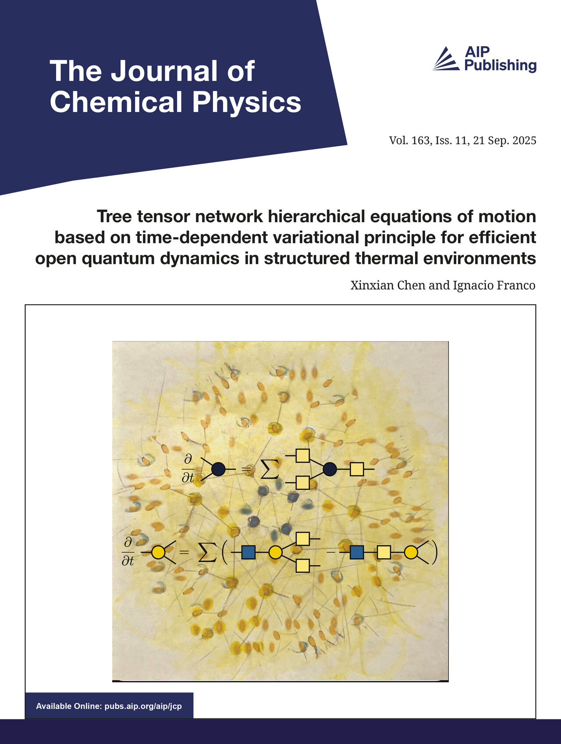
Tree Tensor Network HEOM and TENSO
Chen and Franco J. Chem. Phys. 163, 104109 (2025)
Editor’s Pick! Cover Article!
https://github.com/ifgroup/pytenso
Enables HEOM computations with highly structured environments
Implements tensor trains and tensor trees
Three propagation strategies (Direct, PS1 and PS2)
Fixed and variable rank propagation strategies
Allows for time-dependent driving and non-commuting fluctuations
Open-source code TENSO

Slide 8
TTN decomposition of the extended density operator
Hypothesis: There is significant redundancy in the bexcitonic space that can be compressed
Extended Density Operator
Put all ADMs in a high-order tensor
Tree-Tensor Network Decomposition
Bexciton indexes in the leafs
System indexes in the root tensor
Polynomial space complexity with K (!)
Notes:
Only keep the largest R values

Slide 9
Sum of product form for the generator of the dynamics
Parallel to Multi-configurational time-dependent Hartree
H. Wang and M. Thoss, JCP 119, 1289 (2003)
Notes:
Only keep the largest R values

Slide 10
Master Equation for Core Tensors
Time Dependent Variational Principle
Root Tensor – Simpler Dynamics
Non-Root Tensors – Requires Regularization
Notes:
Only keep the largest R values

Slide 11
Propagation Strategies
Adapt propagation strategies from MCTDH to the TTN-HEOM
Projector Splitting 1
Trotterization algorithm. Errors determined by split time step
Challenging to parallelize
Fixed rank
Adapted also by Ke in JCP 158, 211102 (2023)
Projector Splitting 2
Similar features to PS1
Two-site algorithm
Adaptive rank
Direct Propagation of Master Equation for Core Tensors
Admits high-order numerical propagation schemes (e.g. Runge-Kutta) and their parallelization
Requires regularization like in MCTDH (specially at early times)
Fixed rank
THIS WORK
Notes:
Only keep the largest R values

Slide 12
TENSO
Implemented in Python with NumPy and PyTorch
Supports HEOM/ML-MCDTH/etc in a unified framework
Supports direct integration, PS1, PS2 and mixed strategies for propagation
Can handle structured baths for molecular systems
Arbitrary tensor trees and tensor order
Open source and available on GitHub
Notes:
Only keep the largest R values

Slide 13

1. Install Anaconda: Creates computational environment with high compatibility between python libraries
A. Download here:
B. Linux Install
4. Go to Downloads folder and open the terminal
5. $ bash ./anaconda_name.sh
6. Refresh the terminal
C. Create TENSO environment
Using bash terminal:
$ conda create --name tenso python=3 matplotlib
$ conda activate tenso
Sign up
Sign in
Download
https://www.anaconda.com/download

Slide 14

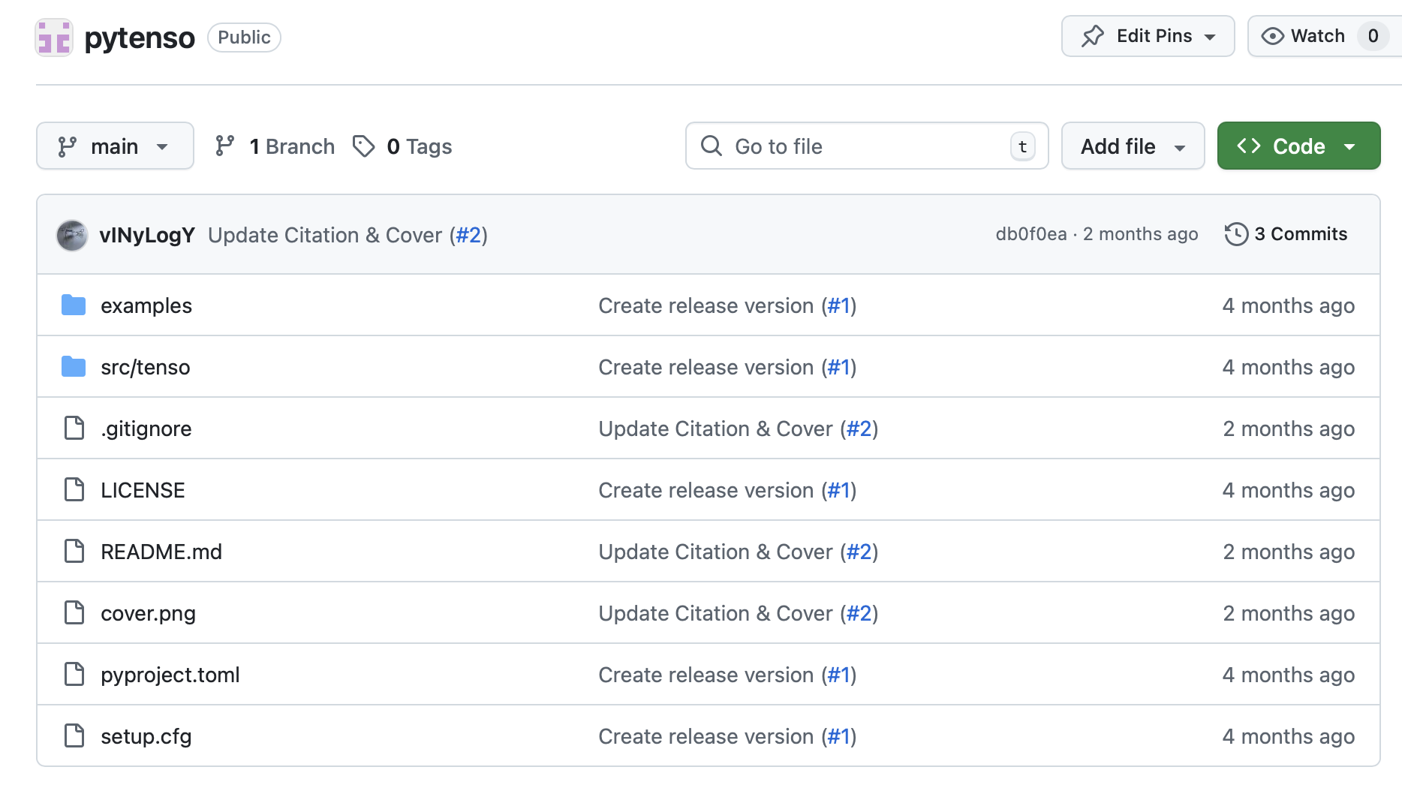
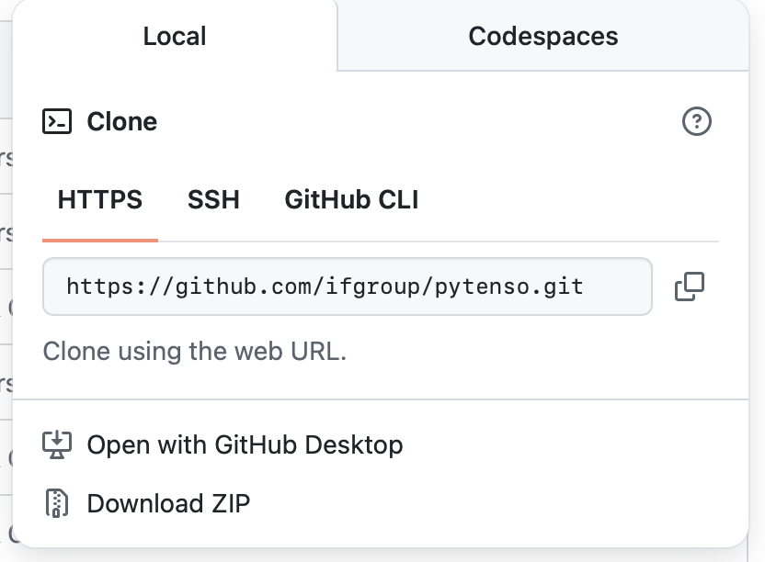
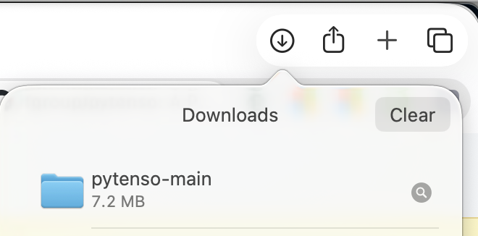
2. Download and Install TENSO from GitHub
TENSO: Tree Tensor Network Equations for Non-Markovian Open Quantum Systems
https://github.com/ifgroup/pytenso
Ubuntu install using bash terminal:
A. Install git
$ sudo apt install git
B. Clone the repository
$ git clone https://github.com/ifgroup/pytenso.git
C. Install tenso in editable mode
$ cd ./pytenso-main
$ python -m pip install -e .
Graphical install
Move pytenso folder to home and unzip
Open the folder in the terminal
Install tenso in editable mode
$ python -m pip install -e .

Slide 15

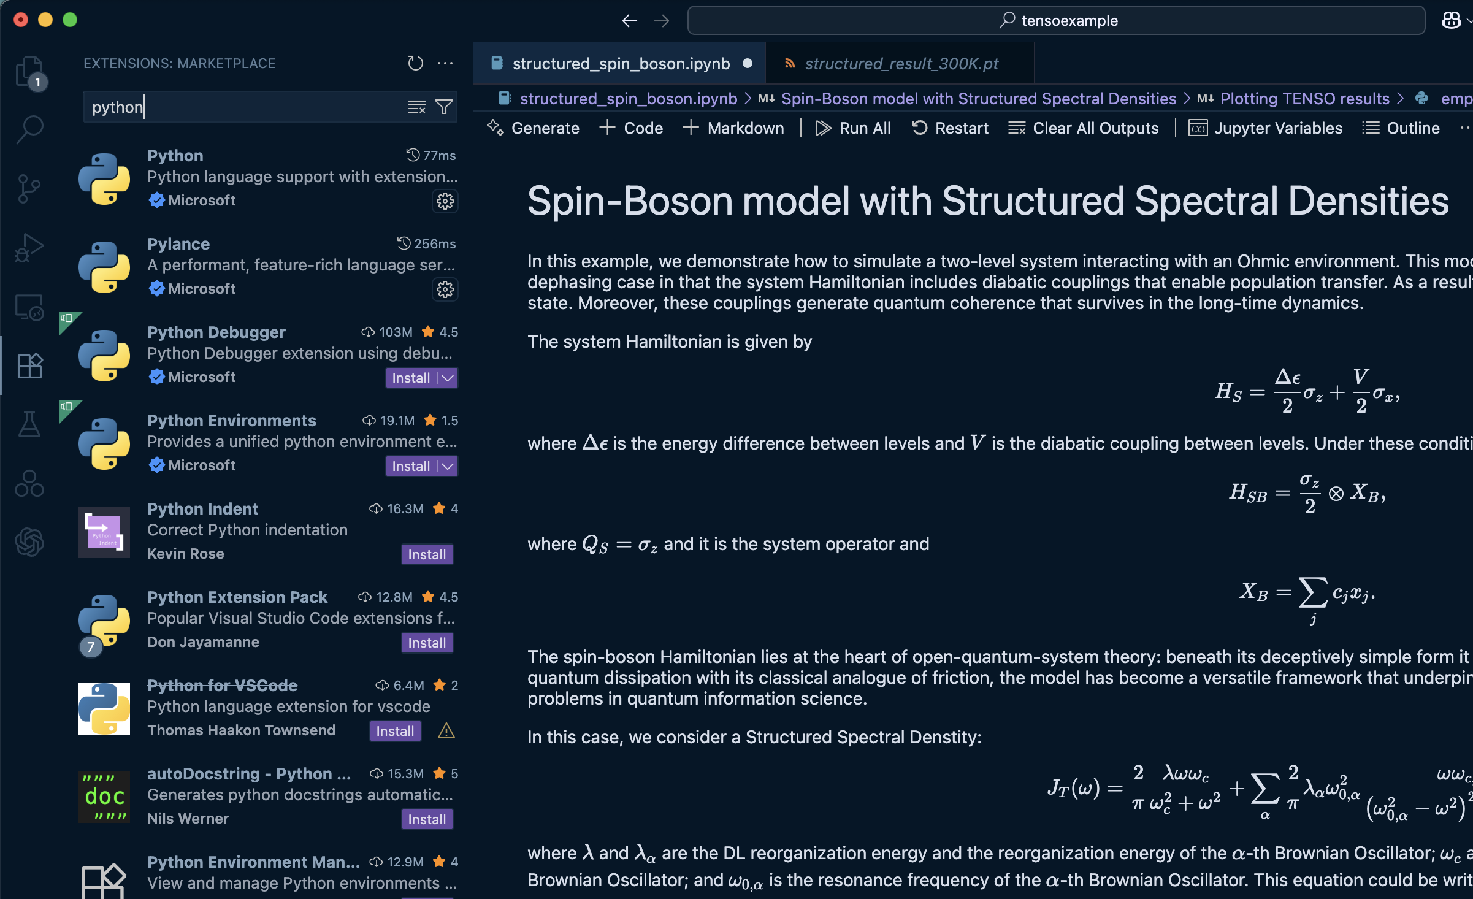
3. Download and Install VS Code: Useful Environment for Computing
https://code.visualstudio.com
Ubuntu Install
Download the .apt file from website
Install
$ sudo apt install ./code_1.107.1-1765982436_amd64.deb
C. Open VS Code
Setup Python and Jupyter
Go to the left panel and click on extensions
Search for python and install
Search for Jupyter and install
Create Jupyter Notebook (File… NewFile)
Select tenso environment or “kernel” on the top right

Slide 16
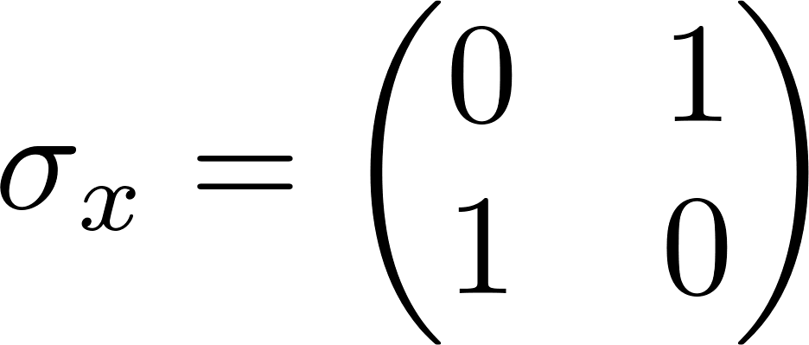
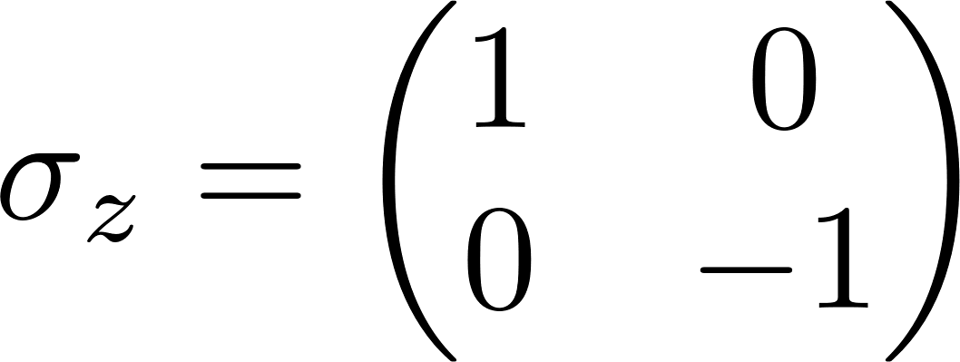
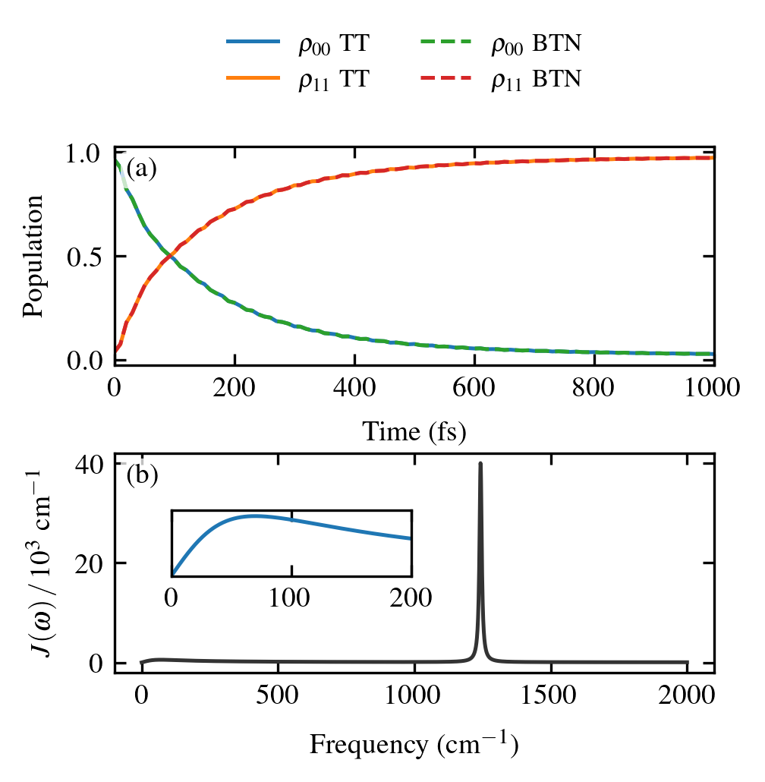
Example 1: Spin-Boson model
Two-level molecule
Harmonic environment
System-Bath coupling
Collective bath coordinate
System operator
Semi-structured environment: 1Drude-Lorentz + 1 Brownian Oscillator

Slide 17
Bath Correlation Function: decompose it into Drude-Lorentz and Brownian oscillator features
(e.g. solvent)
(e.g. vibrations)
Odd extension correlation function
Using Padé/Matsubara + Residue Theorem

Slide 18
4. Import relevant libraries (always needed)
from math import ceil
import os
import json as json
import numpy as np
from tqdm import tqdm
from tenso.prototypes.heom import spin_boson #Spin-boson helper function
from tenso.prototypes.bath import gen_bcf #Bath correlation function generator
import matplotlib.pyplot as plt
Test: Execute with python using tenso environment to check the correct installation

Slide 19
5. Generate Bath Correlation Function (1DL + 1BO)
bath_simulation = gen_bcf(
re_d=[540], #Reorganization energy in cm-1
width_d=[70], #Cutoff frequency of the DL spectral density in cm-1
freq_b=[1243], # Central Frequency of the Brownian Spectral density in cm-1
re_b=[161.6], #Reorganization energy of the Brownian Spectral density in cm-1
width_b=[10], #Width of the spectral density in cm-1
temperature=300, #Temperature in Kelvin
decomposition_method='Pade', #Decomposition method for the bath correlation function
n_ltc=1, #Number of low-temperature correction terms
)
Notes:
You can add more features in the spectral densities by adding items to the lists: re_d, width_d, freq_b, re_b, width_b
2. You can choose a different decomposition method including ‘Pade’ , ‘Matsubara’, or ‘TEDOPA’
3. If you get any errors, try removing the tenso environment (i.e. conda env remove --name tenso)
and repeat the tenso installation process

Slide 20
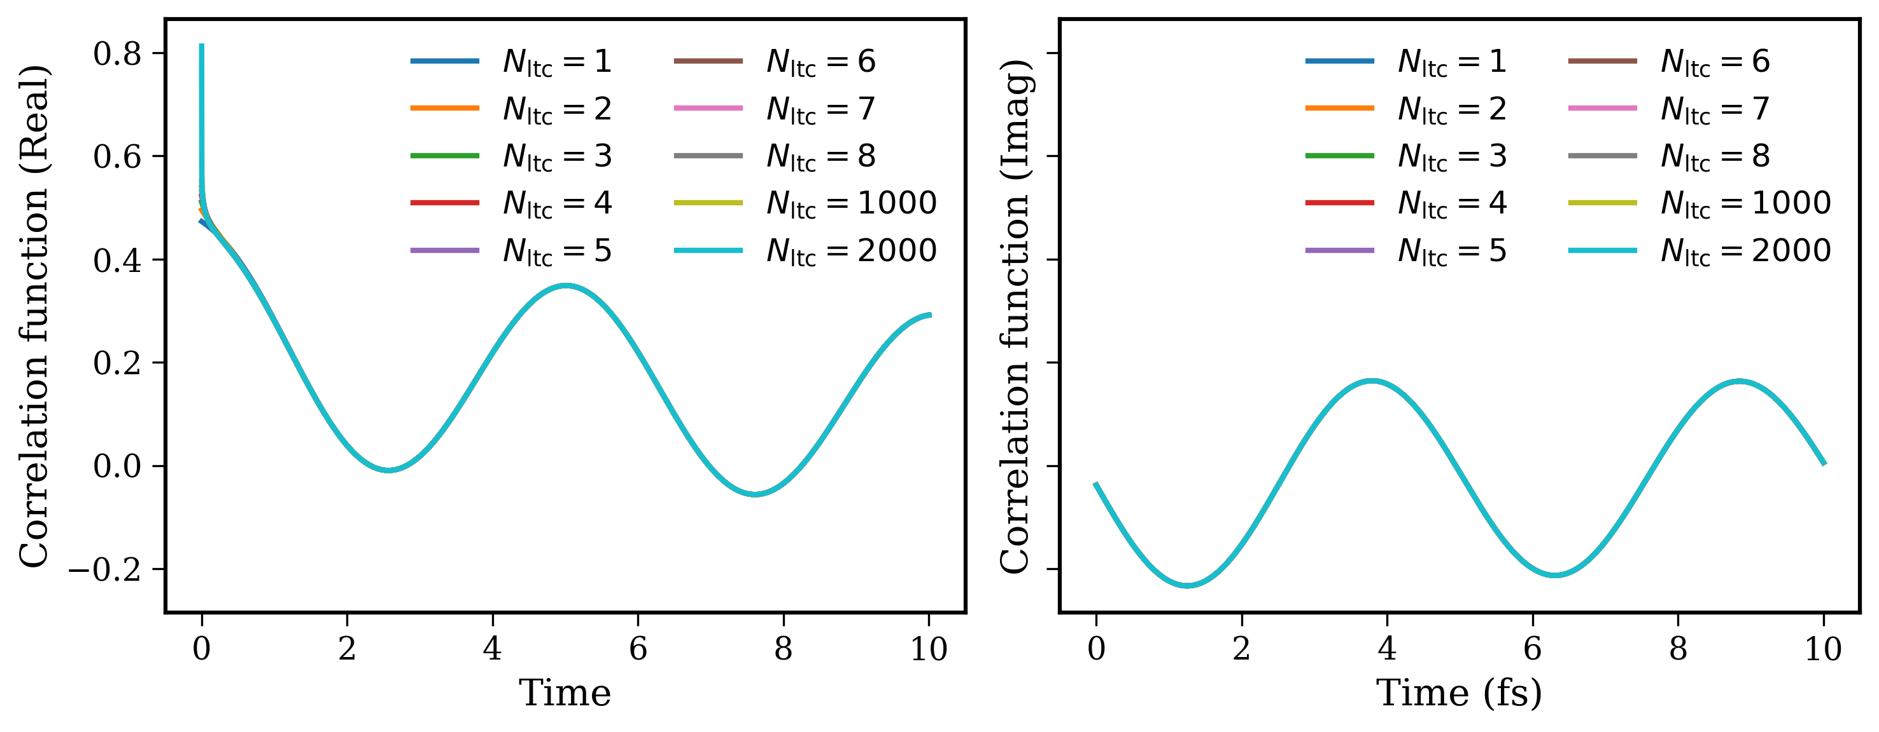
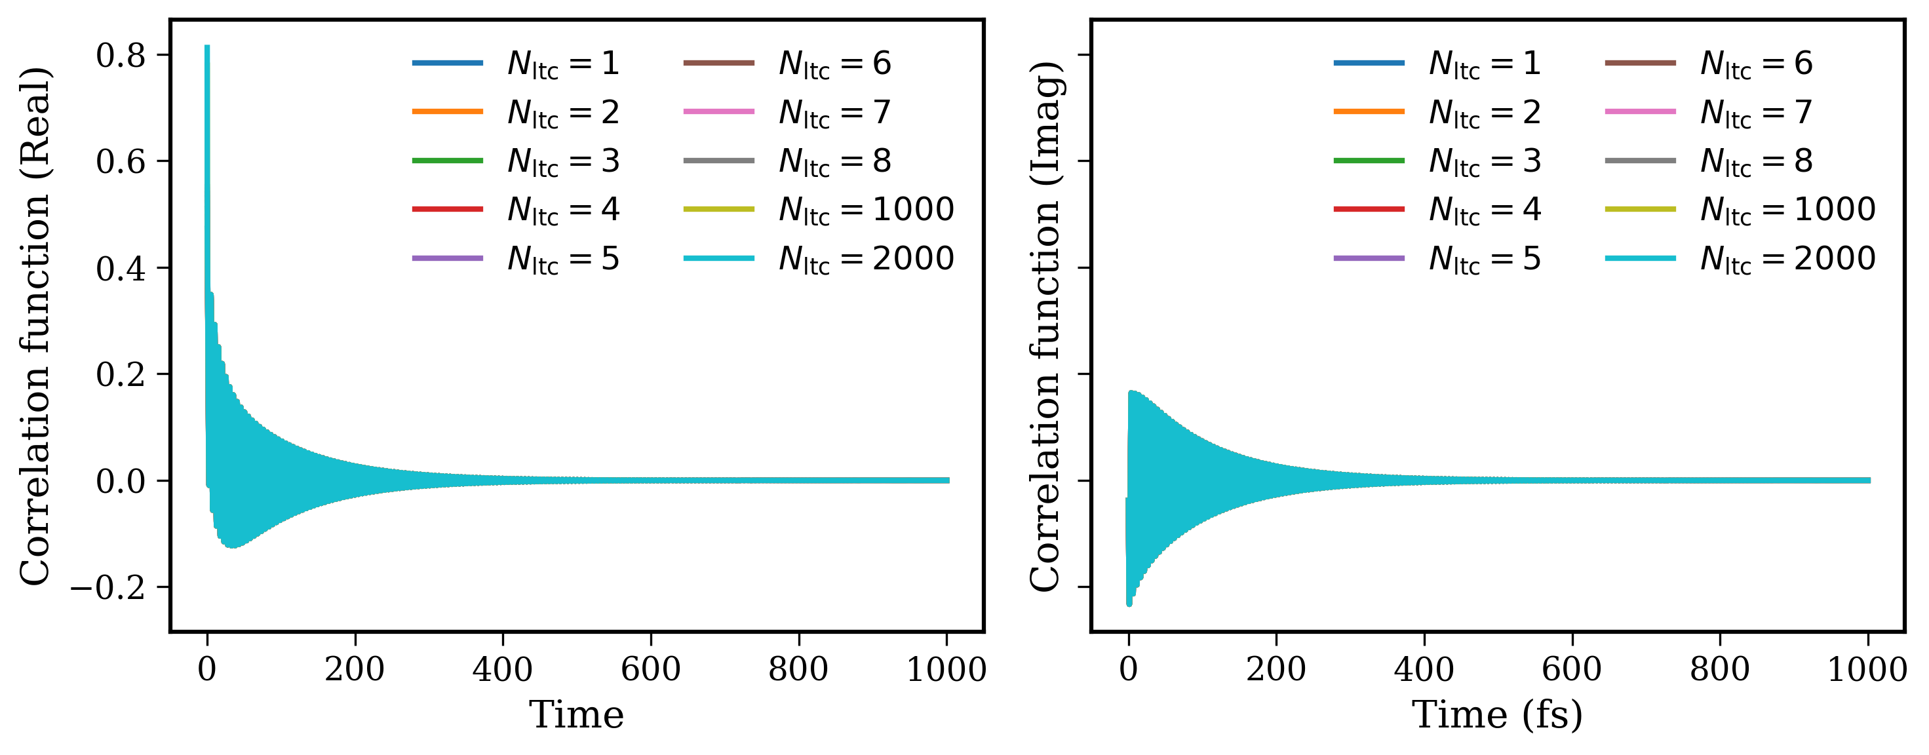
6. Sanity check: plot Bath Correlation Function (1DL + 1BO)
Use this:
import numpy as np
import matplotlib.pyplot as plt
plt.rcParams.update({
'font.family': 'serif',
'font.size': 12,
'axes.linewidth': 1.5,
'axes.labelsize': 14,
'axes.titlesize': 16,
'lines.linewidth': 2,
'xtick.direction': 'out',
'ytick.direction': 'out',
'xtick.major.size': 5,
'ytick.major.size': 5,
'legend.fontsize': 12,
'figure.dpi': 300,
})
# --- time ---
t = np.linspace(0, 10, 10000)
fig, (ax_real, ax_imag) = plt.subplots(1, 2, figsize=(10, 4), sharey=True)
def plot_bcf(n_ltc):
bath = gen_bcf(
re_d=[540],
width_d=[70],
freq_b=[1243],
re_b=[161.6],
width_b=[10],
temperature=300,
decomposition_method='Pade',
n_ltc=n_ltc,
)
#print(bath, flush=True)
ax_real.plot(t, bath.real_correlation_function(t), label=fr'$N_{{\rm ltc}}={n_ltc}$')
ax_imag.plot(t, bath.imag_correlation_function(t), label=fr'$N_{{\rm ltc}}={n_ltc}$')
for n_ltc in [1, 2, 3, 4, 5, 6, 7, 8, 1000, 2000]:
plot_bcf(n_ltc)
ax_real.set_xlabel('Time')
ax_real.set_ylabel(r'Correlation function (Real)')
ax_real.legend(frameon=False, ncol=2)
#ax_real.set_xlim(0, 0.25)
ax_real.grid(False)
ax_imag.set_xlabel('Time (fs)')
ax_imag.set_ylabel(r'Correlation function (Imag)')
ax_imag.legend(frameon=False, ncol=2)
#ax_imag.set_xlim(0, 0.25)
ax_imag.grid(False)
plt.tight_layout()
plt.savefig('bath_correlation_horizontal.png', dpi=300, transparent=True)
plt.show()
Second test: You should be able to generate this plot (see code to the right)

Slide 21
7. System parameters and quantum dynamics
H = np.array([[1500/2, 600/2], [600/2, -1500/2]], dtype=np.complex128)
# Diagonalization
evals, U = np.linalg.eigh(H)
id_max = np.argmax(evals)
end_time = 1000.0 #fs
dt = 1
wfn = U[:, id_max ] #Eigenstate with highest energy
out = 'spin_boson_example'
propagator = spin_boson(
fname=out,
init_rdo=np.outer(wfn, wfn.conj()),
sys_ham=np.array([[1500/2, 600/2], [600/2, -1500/2]], dtype=np.complex128),
sys_op=np.array([[0.5, 0.0], [0.0, -0.5]], dtype=np.complex128),
bath_correlation=bath_simulation,
dim=10,
end_time=end_time,
step_time=dt,
save_checkpoint_to_file=True,
)
progress_bar = tqdm(propagator, total=ceil(end_time / dt))
for _t in (progress_bar):
progress_bar.set_description(f'@{_t:.2f} fs')
The spin_boson() helper function propagates the system’s dynamics coupled to a single bosonic bath.

Slide 22
8. Output
A. Progress bar and details of the computation
{'dim': 10, 'end_time': 1000.0, 'step_time': 1, 'save_checkpoint_to_file': True}
{'auxiliary_ps_method': 'ps2', 'auxiliary_step_time': None, 'cache_svd_info': True, 'dim': 10, 'dvr_length': 32, 'dvr_type': 'sine', 'end_time': 1000.0, 'frame_method': 'tree2', 'load_checkpoint_from_file': False, 'max_auxiliary_rank': 32, 'max_auxiliary_steps': None, 'metric': 're', 'ode_atol': 1e-07, 'ode_method': 'dopri5', 'ode_rtol': 1e-05, 'ps2_atol': 1e-07, 'ps2_ratio': 2.0, 'ps_method': 'vmf', 'rank': 3, 'renormalize': False, 'save_checkpoint_to_file': True, 'start_time': 0.0, 'step_time': 1, 'stepwise_method': 'mix', 'use_dvr': False, 'visualize_frame': False, 'vmf_atol': 1e-07, 'vmf_reg_method': 'extend', 'vmf_reg_type': 'ip'}
For k=0: s:0.22307229 | e:0.00000000 | a:-0.03780000 | f:0.47230529 | f^2:0.22307229 #
For k=1: s:0.10095920 | e:0.10044090 | a:0.00002494 | f:-0.31774078 | f^2:0.10095920
For k=2: s:0.10095920 | e:-0.10044090 | a:-0.00002494 | f:0.31774078 | f^2:0.10095920
For k=3: s:0.04791662 | e:0.00000000 | a:-0.00000000 | f:0.21889865 | f^2:0.04791662
@5.00 fs: 1%| | 6/1000 [00:01<05:49, 2.84it/s]Switched to vmf.
@745.00 fs: 75%|███████▍ | 746/1000 [03:49<01:20, 3.14it/s]
Some important ones:
dim: depth of HEOM
Stepwise_method: ‘mix’ signals mixed propagation method
[first auxiliary_ps_method (ps2 in this case), then ps_method (vmf or direct in this case)]
frame_method: ‘tree2’ is a binary tree
Others: threshold tolerance integration, regularization, maximum rank and rank tolerance in PS2
Coefficients of BCF decomposition into features (details in src/tenso/heom/eom.py)
Here k=0 is for DL, k=1,2 is for BO and k=3 is low-temperature correction
Notes:
Output structure
The output structure is divided in three main components:
The first component is related to the dynamic's parameters along with the ‘dim’(hierarchy depth) convergence parameter. ‘end_time’ is the time until we want to run de dynamics, ‘step_time’ could mean different things depending on the chosen propagation method. In this example, the propagation method is a combination between ps2 (second order projector-splitting) and direct integration. For the ps2 part, the ’step_time’ parameter contains one forward iteration and one backward iteration, so that dt/2 is passed to the ODE solver. ‘save_checkpoint_to_file’ generates a .pt that stores the information to continue the simulation later.

Slide 23
8. Output
A. Progress bar and details of the computation
B. Output File: Reduced density matrix every dt
time rdo00 rdo01 rdo10 rdo11
C. Output Debug File
time ode_steps max_rank tr norm
Enjoy running numerically exact dissipative dynamics!
Notes:
Output structure
The output structure is divided in three main components:
The first component is related to the dynamic's parameters along with the ‘dim’(hierarchy depth) convergence parameter. ‘end_time’ is the time until we want to run de dynamics, ‘step_time’ could mean different things depending on the chosen propagation method. In this example, the propagation method is a combination between ps2 (second order projector-splitting) and direct integration. For the ps2 part, the ’step_time’ parameter contains one forward iteration and one backward iteration, so that dt/2 is passed to the ODE solver. ‘save_checkpoint_to_file’ generates a .pt that stores the information to continue the simulation later.

Slide 24
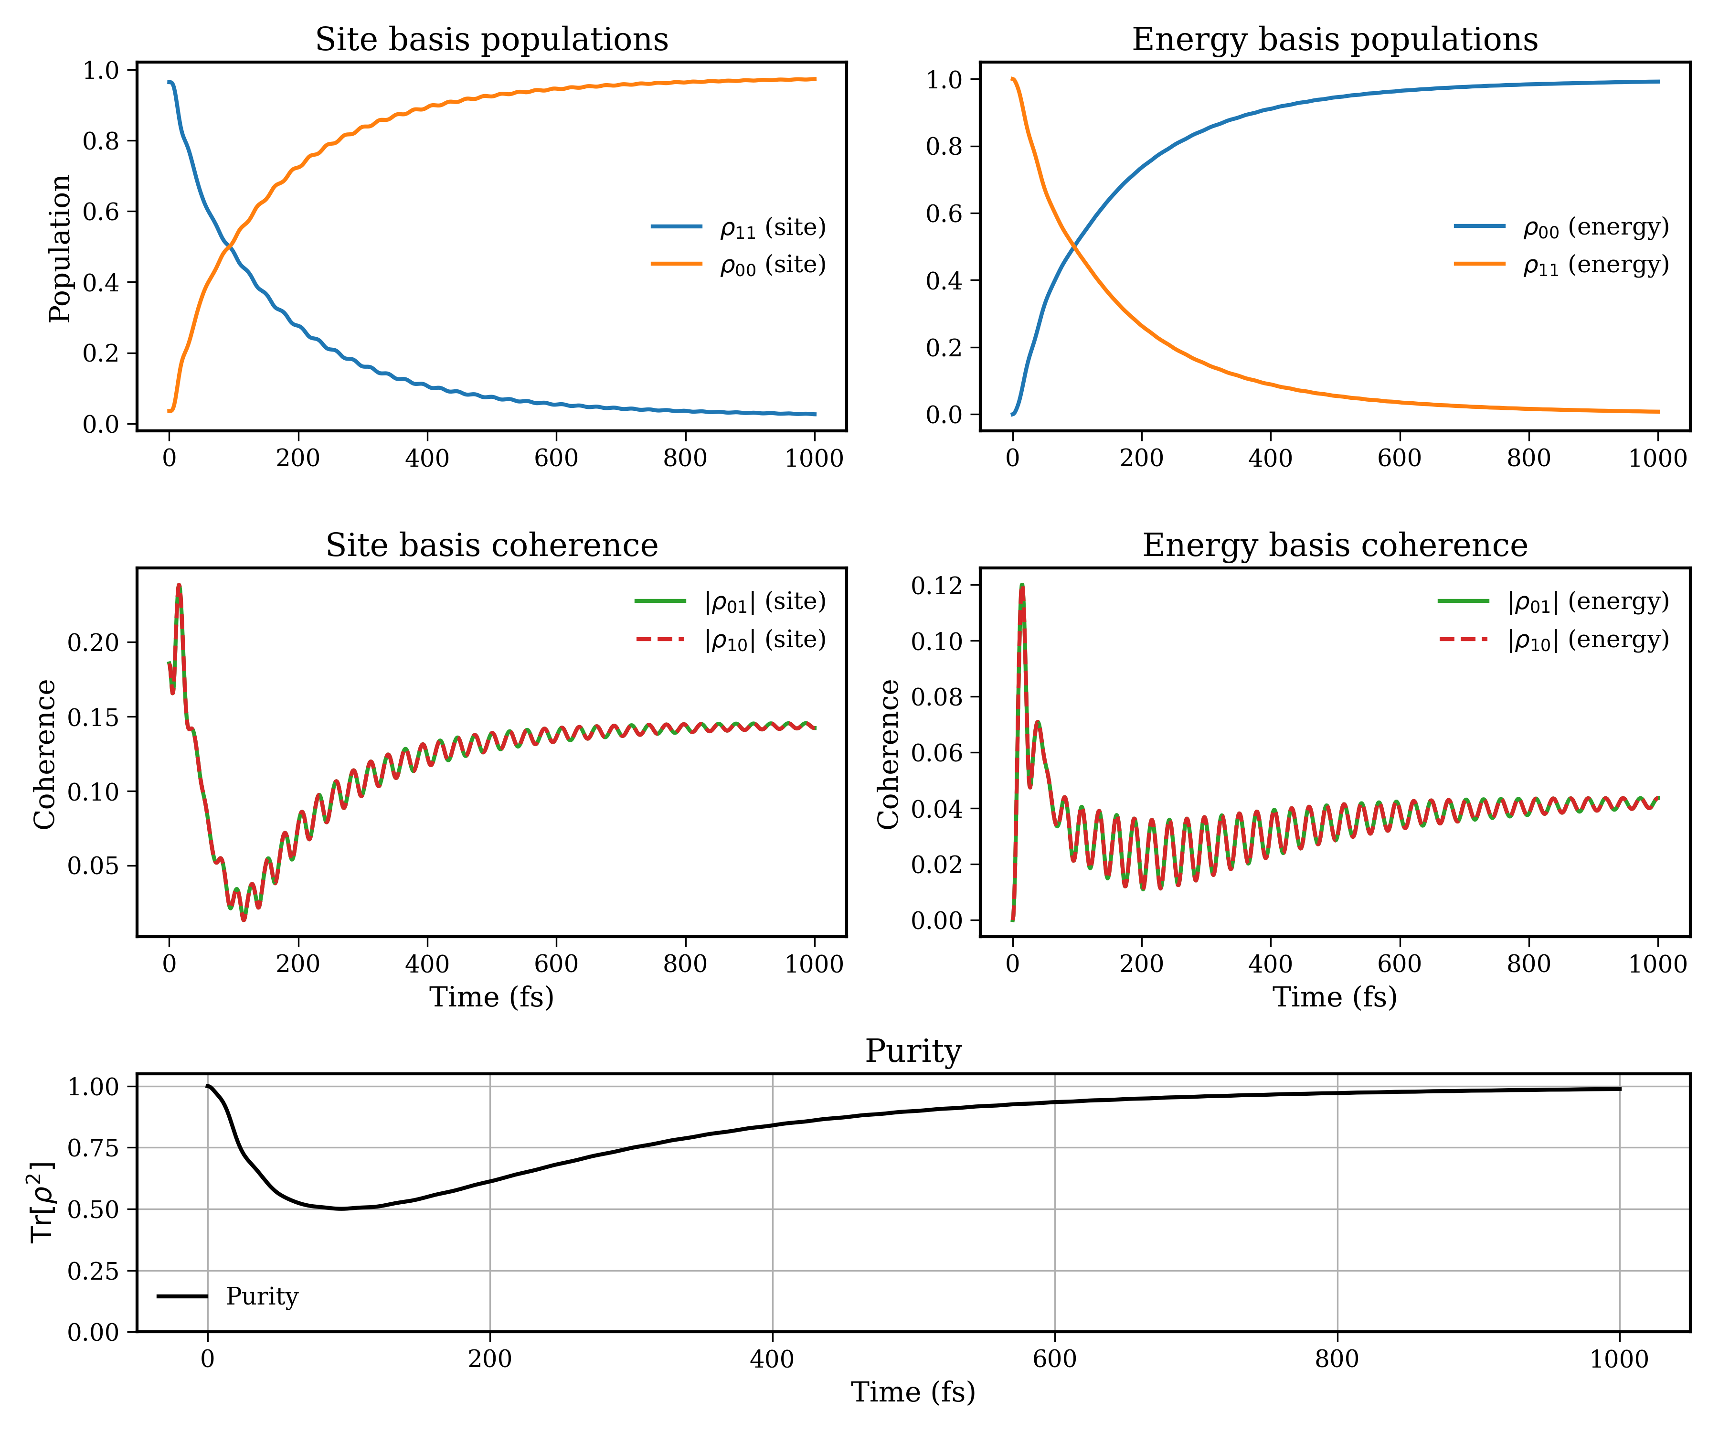
Results
Use this to graph:
import numpy as np
import matplotlib.pyplot as plt
plt.rcParams.update({
'font.family': 'serif',
'font.size': 12,
'axes.linewidth': 1.5,
'axes.labelsize': 14,
'axes.titlesize': 16,
'lines.linewidth': 2,
'xtick.direction': 'out',
'ytick.direction': 'out',
'xtick.major.size': 5,
'ytick.major.size': 5,
'legend.fontsize': 12,
'figure.dpi': 300,
})
filename = 'spin_boson_example.dat.log'
data = np.loadtxt(filename, delimiter=' ', dtype=complex)
t_fs = data[:, 0].real
pop_exc = data[:, 1].real
coh_01 = data[:, 2]
coh_10 = data[:, 3]
pop_gnd = data[:, 4].real
# Site basis Hamiltonian
H = np.array([[1500/2, 600/2], [600/2, -1500/2]], dtype=np.complex128)
evals, U = np.linalg.eigh(H)
print(U.T.conj() @ H @ U)
# Energy basis transformation and purity
pop_e0 = []
pop_e1 = []
coh_e01 = []
coh_e10 = []
purity = []
for p00, p11, p01, p10 in zip(pop_gnd, pop_exc, coh_01, coh_10):
rho_site = np.array([[p11, p10], [p01, p00]], dtype=np.complex128)
purity.append(np.real(np.trace(rho_site @ rho_site)))
rho_e = U.conj().T @ rho_site @ U
pop_e0.append(rho_e[0, 0].real)
pop_e1.append(rho_e[1, 1].real)
coh_e01.append(rho_e[0, 1])
coh_e10.append(rho_e[1, 0])
pop_e0 = np.array(pop_e0)
pop_e1 = np.array(pop_e1)
coh_e01 = np.array(coh_e01)
coh_e10 = np.array(coh_e10)
purity = np.array(purity)
fig = plt.figure(figsize=(12, 10))
gs = fig.add_gridspec(3, 2, height_ratios=[1, 1, 0.7])
# Panel 1: Populations in site basis
ax1 = fig.add_subplot(gs[0, 0])
ax1.plot(t_fs, pop_exc, '-', color='C0', label=r'$\rho_{11}$ (site)')
ax1.plot(t_fs, pop_gnd, '-', color='C1', label=r'$\rho_{00}$ (site)')
ax1.set_ylabel('Population')
ax1.set_title('Site basis populations')
ax1.legend(frameon=False)
ax1.grid(False)
# Panel 2: Coherences in site basis
ax2 = fig.add_subplot(gs[1, 0])
ax2.plot(t_fs, np.abs(coh_01), '-', color='C2', label=r'$|\rho_{01}|$ (site)')
ax2.plot(t_fs, np.abs(coh_10), '--', color='C3', label=r'$|\rho_{10}|$ (site)')
ax2.set_xlabel('Time (fs)')
ax2.set_ylabel('Coherence')
ax2.set_title('Site basis coherence')
ax2.legend(frameon=False)
ax2.grid(False)
# Panel 3: Populations in energy basis
ax3 = fig.add_subplot(gs[0, 1])
ax3.plot(t_fs, pop_e0, '-', color='C0', label=r'$\rho_{00}$ (energy)')
ax3.plot(t_fs, pop_e1, '-', color='C1', label=r'$\rho_{11}$ (energy)')
ax3.set_title('Energy basis populations')
ax3.legend(frameon=False)
ax3.grid(False)
# Panel 4: Coherences in energy basis
ax4 = fig.add_subplot(gs[1, 1])
ax4.plot(t_fs, np.abs(coh_e01), '-', color='C2', label=r'$|\rho_{01}|$ (energy)')
ax4.plot(t_fs, np.abs(coh_e10), '--', color='C3', label=r'$|\rho_{10}|$ (energy)')
ax4.set_xlabel('Time (fs)')
ax4.set_ylabel('Coherence')
ax4.set_title('Energy basis coherence')
ax4.legend(frameon=False)
ax4.grid(False)
# Panel 5: Purity
ax5 = fig.add_subplot(gs[2, :])
ax5.plot(t_fs, purity, '-', color='k', label='Purity')
ax5.set_xlabel('Time (fs)')
ax5.set_ylabel(r'$\mathrm{Tr}[\rho^2]$')
ax5.set_title('Purity')
ax5.set_ylim(0, 1.05)
ax5.legend(frameon=False)
ax5.grid(True)
plt.tight_layout()
plt.savefig('combined_plot_site_energy_purity_structured.png', dpi=300, transparent=True)
plt.show()

Slide 25
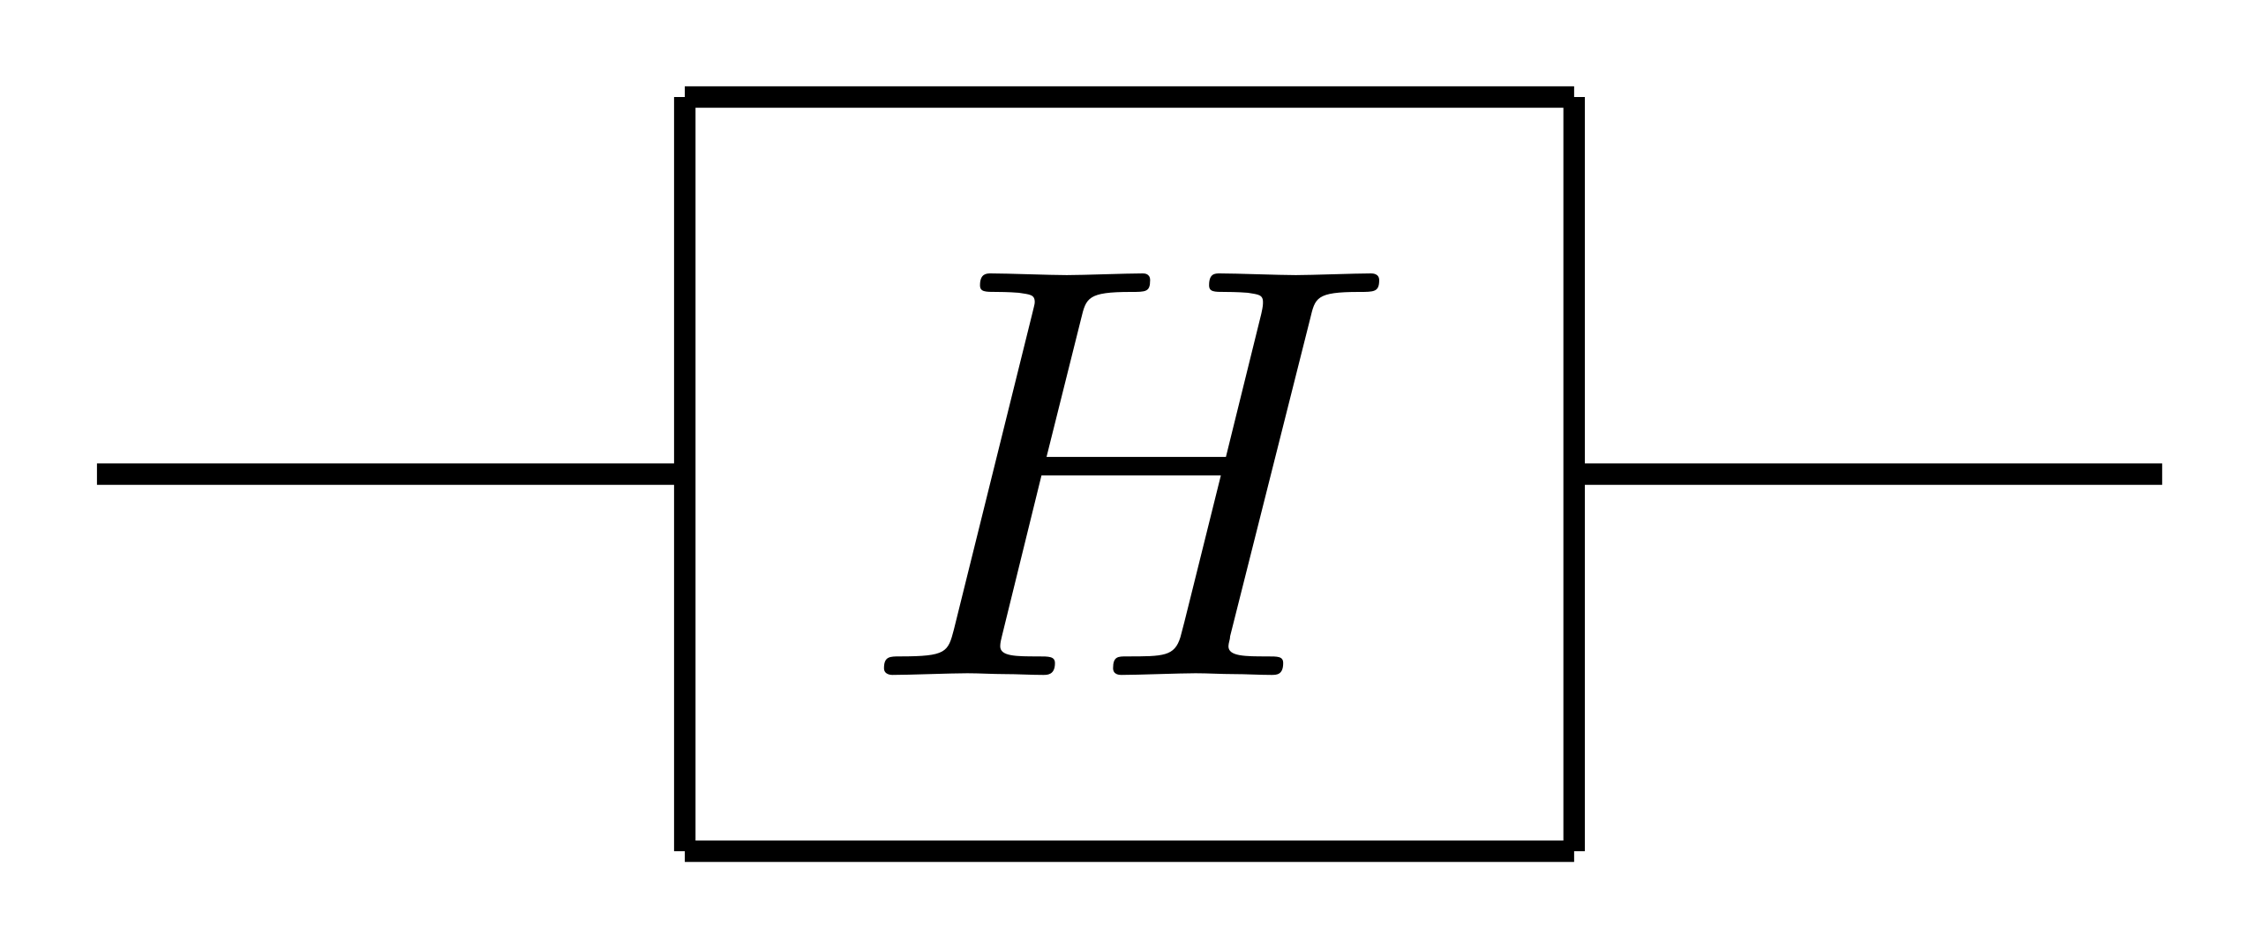
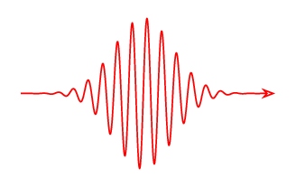
Example 2: Driven Spin Boson model
Two-level molecule
Harmonic environment
System-Bath coupling
Collective bath coordinate
System operator
Semi-structured environment: 1Drude-Lorentz + 1 Brownian Oscillator

Slide 26
Example 2: Driven Spin Boson model
1. Import relevant libraries as before. In addition, use:
from tenso.prototypes.default_parameters import quantity
(“quantity” transforms typical physical units eV, J, meV, fs, ps, s, K, A, m, pm, kg, cm⁻¹ to TENSO internal units)
2. Define BCF (use the same)
3. Define the dynamics parameters and initial state
end_time = 40.0 # fs
dt = 0.05 # fs
wfn = np.array([0.0, 1.0], dtype=np.complex128) # Start in Ground State |0> (convention [exc, gnd])

Slide 27
Example 2: Driven Spin Boson model
4. Define the drive parameters and drive function. Note the time-dependent part must be converted to TENSO units
# Conversions and Constants. cm is wavenumbers (cm-1)
Hartree_to_cm = 219474.6313705
cm_to_Ha = 1.0 / Hartree_to_cm
fs_to_au = 41.341374576
# System Parameters
delta_Eps_cm = 1500.0 #Energy gap
mu_au = 3.31356454592 # Your dipole moment
delta_Eps_qt = quantity(delta_Eps_cm, 'energy') #Convert gap from cm-1 to a.u.
# Drive parameters
FWHM_fs = 5.0
sigma_fs = FWHM_fs / (2 * np.sqrt(2 * np.log(2))) #Pulse width
t0_fs = 6.0 # Pulse center
sigma_au_val = sigma_fs * fs_to_au
target_envelope_area = np.pi #two times the target pulse area
E0_au = target_envelope_area / (mu_au * sigma_au_val * np.sqrt(2 * np.pi))
interaction_max_cm = (mu_au * E0_au) * Hartree_to_cm
V0_qt = quantity(interaction_max_cm, 'energy')
sigma_qt = quantity(sigma_fs, 'time')
t0_qt = quantity(t0_fs, 'time')
def laser_field_hadamard(t):
envelope = np.exp(-0.5 * ((t - t0_qt) / sigma_qt)**2) # Gaussian Envelope
carrier = np.cos(delta_Eps_qt * t) # Carrier
return -V0_qt * envelope * carrier
print(f"--- Laser Parameters (Based on mu = {mu_au} a.u.) ---")
print(f"Required envelope area: {target_envelope_area:.4f} (Pi)")
print(f"Electric Field Amplitude E0: {E0_au:.6f} a.u.")
print(f"Max Interaction Energy (mu*E0): {interaction_max_cm:.2f} cm^-1")

Slide 28
Example 2: Driven Spin Boson model
5. Same as in the undriven spin_boson. But now ‘td_f’ and ‘td_op’ are added. ‘td_f’ is the time dependent field and ‘td_op’ is the coupling operator with the field
propagator = spin_boson(
fname='laser_example',
init_rdo=np.outer(wfn, wfn.conj()),
sys_ham=np.array([[delta_Eps_cm/2, 0.0], [0.0, -delta_Eps_cm/2]], dtype=np.complex128),#System Hamiltonian
sys_op=np.array([[0.5, 0.0], [0.0, -0.5]], dtype=np.complex128),#System operator (sigma_z/2)
bath_correlation=bath_simulation,
td_f=laser_field_hadamard,#Laser field
td_op = np.array([[0.0, 1.0], [1.0, 0.0]], dtype=np.complex128),# light-matter coupling (sigma_x)
dim=30,
end_time=end_time,
step_time=dt,
save_checkpoint_to_file=True,
)
progress_bar = tqdm(propagator, total=ceil(end_time / dt))
for _t in (progress_bar):
progress_bar.set_description(f'@{_t:.2f} fs')

Slide 29
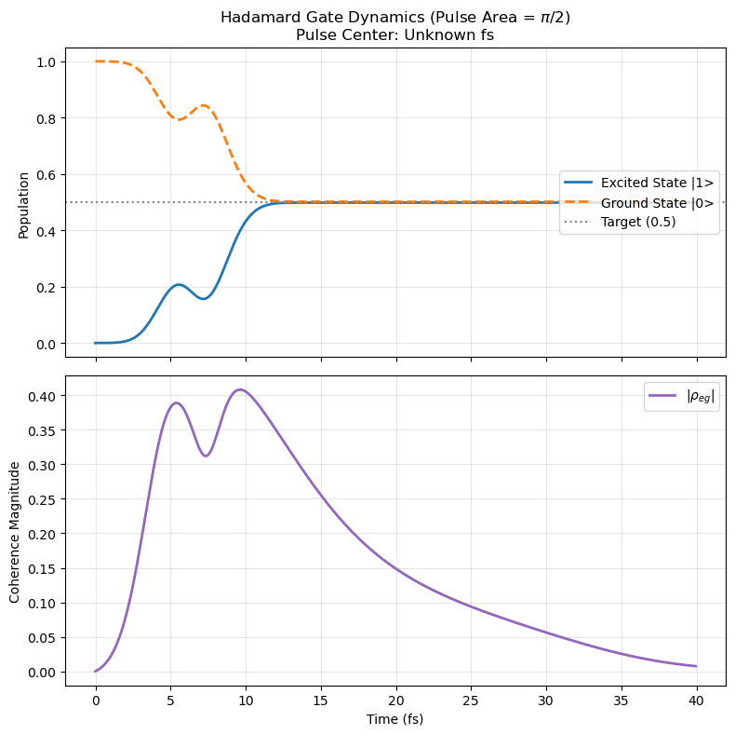
Example 2: Driven Spin Boson model
import matplotlib.pyplot as plt
import numpy as np
# Load data
# Ensure the file exists, or this line will raise an error
data = np.loadtxt(f"laser_example.dat.log", dtype=np.complex128)
# Extract real parts for Time and Populations
t_plot = data[:, 0].real
pop_exc = data[:, 1].real
coh_eg = data[:, 2] # Complex number
coh_ge = data[:, 3] # Complex number
pop_gnd = data[:, 4].real
# Check if t0_fs is defined (for the title), otherwise set a default
if 't0_fs' not in locals():
t0_fs = "Unknown"
print(f"\nFinal Population Excited: {pop_exc[-1]:.4f}")
print(f"Final Population Ground: {pop_gnd[-1]:.4f}")
# --- Plotting ---
# Create 2 vertical subplots, sharing the X axis
fig, (ax1, ax2) = plt.subplots(2, 1, figsize=(8, 8), sharex=True)
# === Upper Panel: Populations ===
ax1.plot(t_plot, pop_exc, label='Excited State |1>', linewidth=2, color='tab:blue')
ax1.plot(t_plot, pop_gnd, '--', label='Ground State |0>', linewidth=2, color='tab:orange')
# Mark the 0.5 target
ax1.axhline(0.5, color='gray', linestyle=':', label='Target (0.5)')
ax1.set_ylabel('Population')
ax1.set_title(f'Hadamard Gate Dynamics (Pulse Area = $\pi/2$)\nPulse Center: {t0_fs} fs')
ax1.legend(loc='center right')
ax1.grid(True, alpha=0.3)
# === Lower Panel: Coherence Modulus ===
# Calculate the absolute value (magnitude)
coh_mag = np.abs(coh_eg)
ax2.plot(t_plot, coh_mag, label=r'$|\rho_{eg}|$', linewidth=2, color='tab:purple')
ax2.set_ylabel('Coherence Magnitude')
ax2.set_xlabel('Time (fs)')
ax2.legend(loc='upper right')
ax2.grid(True, alpha=0.3)
# Adjust layout to prevent overlap
plt.tight_layout()
# Save and Show
plt.savefig("laser_example_population_plot.png", dpi=300, transparent=True)
plt.show()
6. Plot (use code in the right)
Population works, but decoherence destroyed phase fidelity!

Slide 30
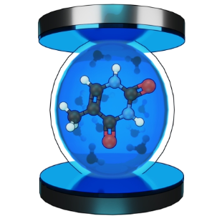
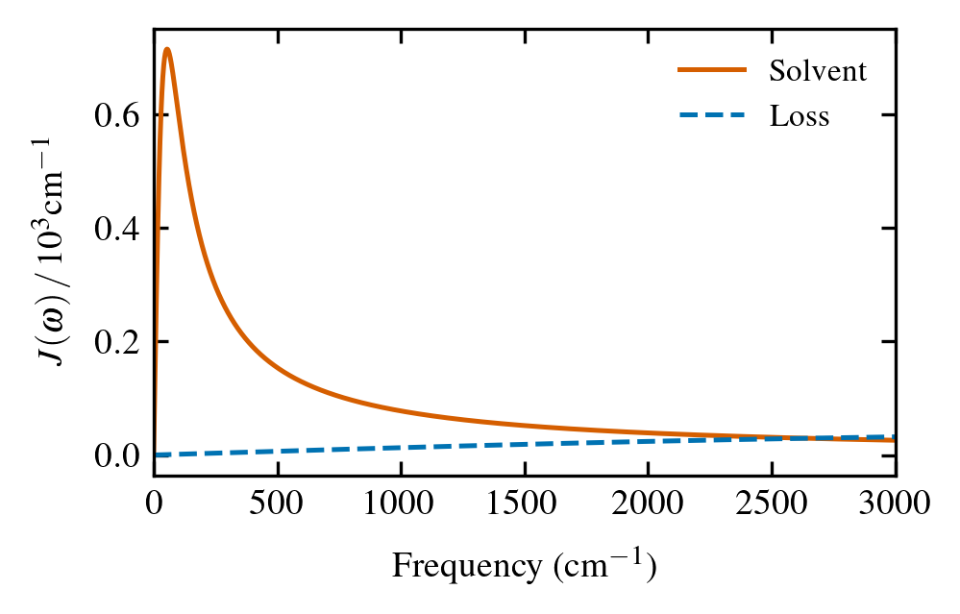
Example 3: Molecule in a cavity
Two-level molecule with one photon
Two Harmonic environments
System-Bath coupling
Simple Environments: 2 Drude-Lorentz

Slide 31
Example 3: Molecule in a cavity
(warning: longer run)
As before:
1. Import relevant libraries as before. In addition, use:
from tenso.prototypes.heom import spin_boson, system_multibath # Add system_multibath() helper function
(“system_multibath” allows to use multiple baths coupled to one system)
2. Define BCFs (both baths)
bath_cavity = gen_bcf(
re_d=[40], #DL spectral densities: reorganization energies in cm-1
width_d=[6000], #DL spectral densities: cutoff frequency in cm-1
temperature=300, #Temperature in Kelvin
decomposition_method='Pade', #Decomposition method for the bath correlation function
n_ltc=3, #Number of low-temperature correction terms
)
bath_solvent = gen_bcf(
re_d=[715.73], #DL spectral densities: reorganization energies in cm-1
width_d=[54.45], #DL spectral densities: cutoff frequency in cm-1
temperature=300, #Temperature in Kelvin
decomposition_method='Pade', #Decomposition method for the bath correlation function
n_ltc=3, #Number of low-temperature correction terms
)

Slide 32
Example 3: Molecule in a cavity
3. Define the bosonic creation and annihilation operators for the cavity:
def get_bosonic_operators(N):
"""
Args:
N (int): The dimension of the Hilbert space.
This accommodates N states: |0> to |N-1>.
Returns:
a (numpy array): Annihilation operator
adag (numpy array): Creation operator
"""
sqrt_numbers = np.sqrt(np.arange(1, N))
a = np.diag(sqrt_numbers, k=1)
adag = a.T.conj()
return a, adag
N = 2 #Fock space dimension
c, cdag = get_bosonic_operators(N)
print("Annihilation operator c:\n", c)
print("\nCreation operator c^dagger:\n", cdag)
These operators are defined to create the cavity and molecule-cavity Hamiltonians

Slide 33
Example 3: Molecule in a cavity
4. Define molecule-cavity system parameters and diagonalize the hamiltonian:
# Define Hamiltonian parameters in cm-1
omega_molecule = 35650
omega_cavity = 35650
g = 806.55
# Build Hamiltonian
g_st = np.array([1, 0])
e_st = np.array([0, 1])
c = np.diag(np.sqrt(np.arange(1, N)), k=1)
cdag = c.T.conj()
H_molecule_cavity = (
np.kron(omega_molecule * np.outer(e_st, e_st), np.eye(N)) +
np.kron(np.eye(2), omega_cavity * (cdag @ c)) +
np.kron(g * np.array([[0, 1], [1, 0]]), (c + cdag))
)
# Diagonalize to find Energy Basis
evals, evecs = np.linalg.eigh(H_molecule_cavity)
The diagonalization is important to plot polaritonic coherences

Slide 34
Example 3: Molecule in a cavity
5. Define system operators for the interaction Hamiltonian:
system_loss_coupling = np.kron(np.eye(2), (c + cdag))
system_solvent_coupling = np.kron(np.outer(e_st, e_st.conj()), np.eye(N))
print("System loss coupling operator:\n", system_loss_coupling)
print("System solvent coupling operator:\n", system_solvent_coupling)
6. Define initial state:
# Identify eigenstates (Energy Basis)
# evecs[:, 0] -> System Ground State (|E0>)
# evecs[:, 1] -> Lower Polariton (|LP>)
psi_E0 = evecs[:, 0] # Ground state
psi_LP = evecs[:, 1] # Lower polariton state
wfn = np.array([0, 1, 0, 0]) # Molecular ground state with one photon
# --- VERIFICATION ---
# Calculate Density Matrix in Site Basis
rho_site = np.outer(wfn, wfn.conj())
# Transform to Energy Basis: rho_E = U.T.conj @ rho_site @ U
# (where U is the matrix of eigenvectors)
rho_energy = evecs.T.conj() @ rho_site @ evecs
print(f"Energy Basis Matrix (Real part):\n{np.round(rho_energy.real, 2)}")
print(f"\nTarget Coherence (Element 0,1): {np.abs(rho_energy[0, 1]):.4f}")

Slide 35
Example 3: Molecule in a cavity
7. Create combined lists of bath and system operators
baths = [bath_cavity] + [bath_solvent] #Baths
Qs = [system_loss_coupling] + [system_solvent_coupling] #System operators
print("Number of baths:", len(baths))
print("Number of system operators:", len(Qs))
8. Create the propagator. In this case, ‘bath_correlations’ and ‘sys_ops’ have lists as arguments. Note that we are not using spin_boson() anymore. We use system_multibath() in turn
end_time = 60.0 # fs
dt = 0.1 # fs
out = "cavity_example"
propagator = system_multibath(
fname=out,
init_rdo=rho_site,
sys_ham=H_molecule_cavity,
sys_ops=Qs,
bath_correlations=baths,
end_time=end_time,
step_time=dt,
dim=20
)
progress_bar = tqdm(propagator, total=ceil(end_time / dt)) #Show the progress bar
for _t in (progress_bar):
progress_bar.set_description(f'@{_t:.2f} fs')

Slide 36
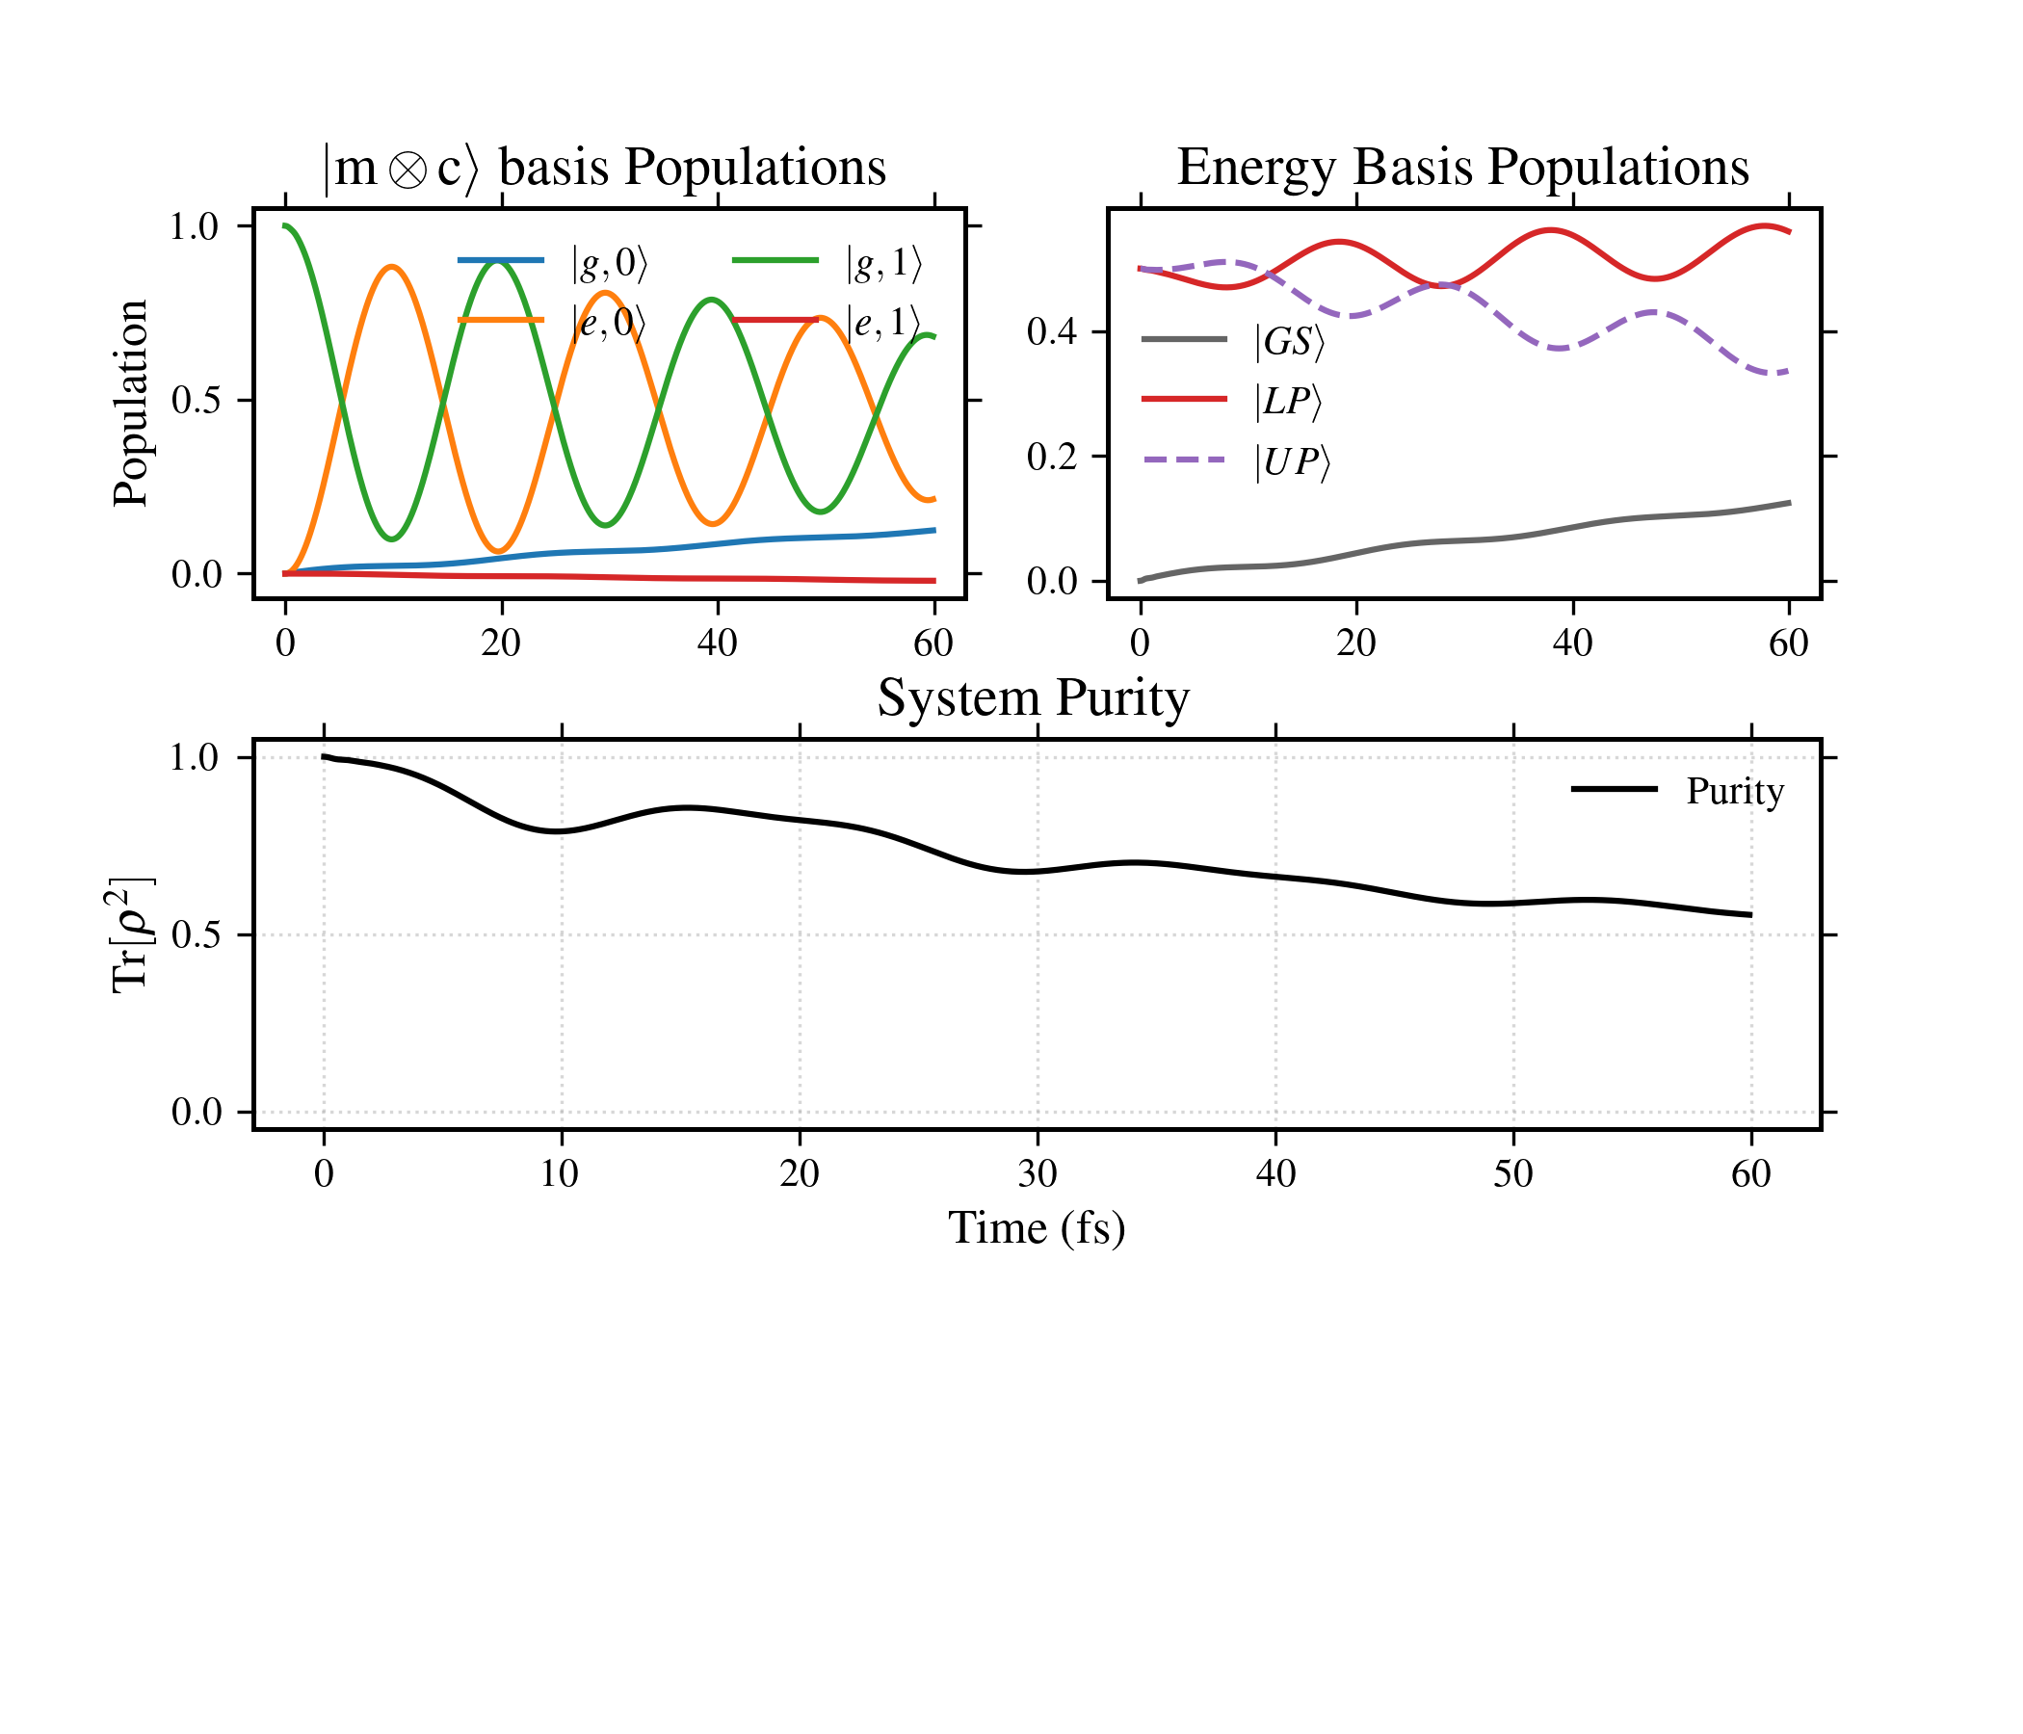
Results
Use this to graph:
import numpy as np
import matplotlib.pyplot as plt
from io import BytesIO
# ---------------------------------------------------------
# 1. Configuration & Style (Your requested style)
# ---------------------------------------------------------
plt.rcParams.update({
'font.family': 'serif',
'font.size': 10,
'axes.linewidth': 1.2,
'axes.labelsize': 12,
'axes.titlesize': 14,
'lines.linewidth': 1.5,
'xtick.direction': 'out',
'ytick.direction': 'out',
'xtick.major.size': 4,
'ytick.major.size': 4,
'legend.fontsize': 10,
'figure.dpi': 300,
})
# ---------------------------------------------------------
# 2. Physics & Hamiltonian (N=2, 4x4 System)
# ---------------------------------------------------------
def get_bosonic_operators(N):
sqrt_numbers = np.sqrt(np.arange(1, N))
a = np.diag(sqrt_numbers, k=1)
adag = a.T.conj()
return a, adag
# Parameters
omega_molecule = 35650
omega_cavity = 35600
g = 806.55
N = 2
# Operators
c, cdag = get_bosonic_operators(N)
g_st = np.array([1, 0])
e_st = np.array([0, 1])
# Hamiltonian (Site Basis)
# Basis Order: |g,0>, |g,1>, |e,0>, |e,1>
H_site = (
np.kron(omega_molecule * np.outer(e_st, e_st), np.eye(N)) +
np.kron(np.eye(2), omega_cavity * (cdag @ c)) +
np.kron(g * np.array([[0, 1], [1, 0]]), (c + cdag))
)
# Diagonalize to get Energy Basis
# evals are energies, U is the transformation matrix (Eigenvectors)
evals, U = np.linalg.eigh(H_site)
print("Eigenvalues (Energy Basis):", np.round(evals, 2))
# ---------------------------------------------------------
# 3. Data Loading (Robust)
# ---------------------------------------------------------
def load_clean_data(filename):
with open(filename, 'r') as f:
lines = f.readlines()
data_lines = [line for line in lines if line.strip() and not line.strip().startswith('#')]
if not data_lines: raise ValueError("No data found")
ncols = len(data_lines[0].split())
clean_lines = [line for line in data_lines if len(line.split()) == ncols]
return np.loadtxt(BytesIO("".join(clean_lines).encode()), dtype=complex)
filename = 'cavity_example.dat.log' # Change this to your file
try:
data = load_clean_data(filename)
t_fs = data[:, 0].real
rho_flattened = data[:, 1:]
except Exception as e:
print(f"Error loading data: {e}")
# Create dummy data for visualization if file missing
t_fs = np.linspace(0, 1000, 100)
rho_flattened = np.zeros((100, 16), dtype=complex)
# ---------------------------------------------------------
# 4. Basis Transformation & Processing
# ---------------------------------------------------------
# Storage for plotting
# Site Basis
pop_g0 = [] # |g,0>
pop_e0 = [] # |e,0>
pop_g1 = [] # |g,1>
pop_e1 = [] # |e,1>
coh_site_ge = [] # Coherence |g,0> <-> |e,0>
# Energy Basis
pop_E0 = [] # Ground State
pop_LP = [] # Lower Polariton (E1)
pop_UP = [] # Upper Polariton (E2)
coh_eng_01 = [] # Coherence Ground <-> LP
coh_eng_12 = [] # Coherence LP <-> UP
purity = []
for row in rho_flattened:
# 1. Reconstruct Site Density Matrix (4x4)
rho_site = row.reshape((2*N, 2*N))
# 2. Purity
purity.append(np.real(np.trace(rho_site @ rho_site)))
# 3. Site Basis Observables
# Indices: 0=|g,0>, 1=|g,1>, 2=|e,0>, 3=|e,1>
pop_g0.append(rho_site[0, 0].real)
pop_e0.append(rho_site[2, 2].real)
pop_g1.append(rho_site[1, 1].real)
pop_e1.append(rho_site[3, 3].real)
coh_site_ge.append(rho_site[0, 2]) # Coherence between g,0 and e,0
# 4. Transform to Energy Basis: rho_E = U^dagger * rho_S * U
rho_eng = U.conj().T @ rho_site @ U
# 5. Energy Basis Observables
# Indices: 0=GS, 1=LP, 2=UP, 3=High
pop_E0.append(rho_eng[0, 0].real)
pop_LP.append(rho_eng[1, 1].real)
pop_UP.append(rho_eng[2, 2].real)
coh_eng_01.append(rho_eng[0, 1]) # Coherence GS <-> LP
coh_eng_12.append(rho_eng[1, 2]) # Coherence LP <-> UP
# Convert lists to arrays
pop_g0 = np.array(pop_g0)
pop_e0 = np.array(pop_e0)
coh_site_ge = np.array(coh_site_ge)
pop_E0 = np.array(pop_E0)
pop_LP = np.array(pop_LP)
pop_UP = np.array(pop_UP)
coh_eng_01 = np.array(coh_eng_01)
coh_eng_12 = np.array(coh_eng_12)
purity = np.array(purity)
# ---------------------------------------------------------
# 5. Plotting (5-Panel Layout)
# ---------------------------------------------------------
fig = plt.figure(figsize=(7, 6))
gs = fig.add_gridspec(3, 2, height_ratios=[1, 1, 0.7], hspace=0.4, wspace=0.2)
# --- Panel 1: Site Populations ---
ax1 = fig.add_subplot(gs[0, 0])
ax1.plot(t_fs, pop_g0, '-', color='C0', label=r'$|g,0\rangle$')
ax1.plot(t_fs, pop_e0, '-', color='C1', label=r'$|e,0\rangle$')
ax1.plot(t_fs, pop_g1, '-', color='C2', label=r'$|g,1\rangle$')
ax1.plot(t_fs, pop_e1, '-', color='C3', label=r'$|e,1\rangle$')
ax1.set_ylabel('Population')
ax1.set_title(r'$|\mathrm{m}\otimes \mathrm{c} \rangle$ basis Populations')
ax1.legend(frameon=False, loc='best', ncol=2)
ax1.grid(False)
# --- Panel 3: Energy Populations ---
ax3 = fig.add_subplot(gs[0, 1])
ax3.plot(t_fs, pop_E0, '-', color='k', alpha=0.6, label=r'$|GS\rangle$')
ax3.plot(t_fs, pop_LP, '-', color='C3', label=r'$|LP\rangle$')
ax3.plot(t_fs, pop_UP, '--', color='C4', label=r'$|UP\rangle$')
ax3.set_title('Energy Basis Populations')
ax3.legend(frameon=False)
ax3.grid(False)
# --- Panel 5: Purity ---
ax5 = fig.add_subplot(gs[1, :])
ax5.plot(t_fs, purity, '-', color='k', linewidth=1.5, label='Purity')
ax5.set_xlabel('Time (fs)')
ax5.set_ylabel(r'$\mathrm{Tr}[\rho^2]$')
ax5.set_title('System Purity')
ax5.set_ylim(-0.05, 1.05)
ax5.legend(frameon=False)
ax5.grid(True, linestyle=':', alpha=0.5)
plt.tight_layout()
plt.savefig('combined_dynamics_molecule_cavity.png', dpi=300, transparent=True)
plt.show()
Imperfect Rabi oscillations due to dissipative environments
Note: For better results, try increasing the Low Temperature Corrections (‘n_ltc’) and depth (‘dim’).

Slide 37
Example 4: Balanced Tree vs Tensor Train
Two-level molecule
Harmonic environment
System-Bath coupling
Collective bath coordinate
System operator
Semi-structured environment: 1Drude-Lorentz + 1 Brownian Oscillator

Slide 38
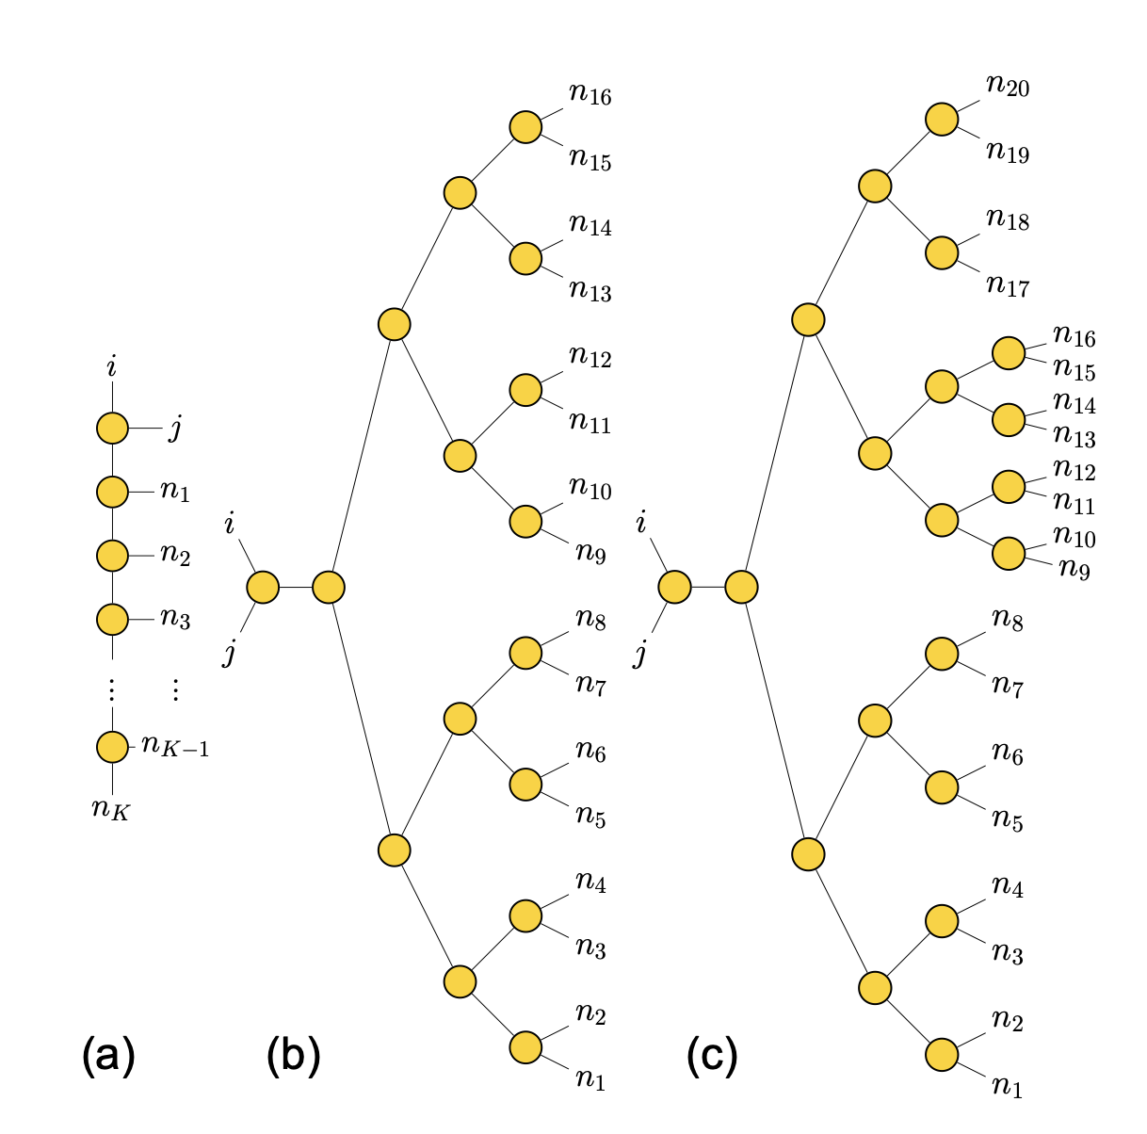
Example 4: Balanced Tree vs Tensor Train
BTT
TENSO admits arbitrary TN structure
It has a helper function to automatically construct two types of TNs:
- Balanced tensor tree (BTT)
- Tensor Train (TT)
Standard TN structures are constructed using the ‘frame_method’ argument in the spin_boson() or system_multibath() propagators:
- ‘tree2’ creates a binary BTT using the Huffman coding method
(Default: all leaves with the same significance → balanced tree)
- ‘train’ creates a TT
- ‘treen’ (n integer) creates n-ary tensor trees
Custom TN can be defined by defining a list of K nodes, links between nodes and a root core. (See also tenso.heom.eom.FrameFactory)
- Use tenso.state.pureframe.Frame to create a Frame object to describe how a TN is connected
- Frame.new_node method to create nodes
- Frame.add_link method to create links between them
TT
Notes:
XC: To manually create the topology of a TN (`Frame`) one can use Frame class. `libs.utils` are actually some helper functions for general coding.

Slide 39
Example 4: Balanced Tree vs Tensor Train
1. Import relevant libraries as before. In addition, use:
2. Define the name of the outputs and the ‘frame_method’, in this case, we use Balanced tree as ‘tree2’ and tensor train as ‘train’.
out_tree = 'tree2' #Output name
out_name = 'train' #Output name
outs = {
'tree2': out_tree,
'train': out_name
}
3. Define the same BCF as in the Spin-Boson example

Slide 40
Example 4: Balanced Tree vs Tensor Train
4. Define system dynamics along with ‘end_time’ and ‘step_time’:
H = np.array([[1500/2, 600/2], [600/2, -1500/2]], dtype=np.complex128)
# Diagonalization
evals, U = np.linalg.eigh(H)
id_max = np.argmax(evals)
end_time = 1000.0 #fs
dt = 1
wfn = U[:, 1]
5. Now propagate adding the ‘frame_method’ parameter and setting it to ‘tree2’ or ‘train’, in this case we use both in a for loop.
for out in outs:
propagator = spin_boson(
fname=out,
init_rdo=np.outer(wfn, wfn.conj()),
sys_ham=H,
sys_op=np.array([[0.5, 0.0], [0.0, -0.5]], dtype=np.complex128),
bath_correlation=bath_simulation,
dim=5,
end_time=end_time,
step_time=dt,
frame_method=out,
)
progress_bar = tqdm(propagator, total=ceil(end_time / dt))
for _t in (progress_bar):
progress_bar.set_description(f'@{_t:.2f} fs')

Slide 41
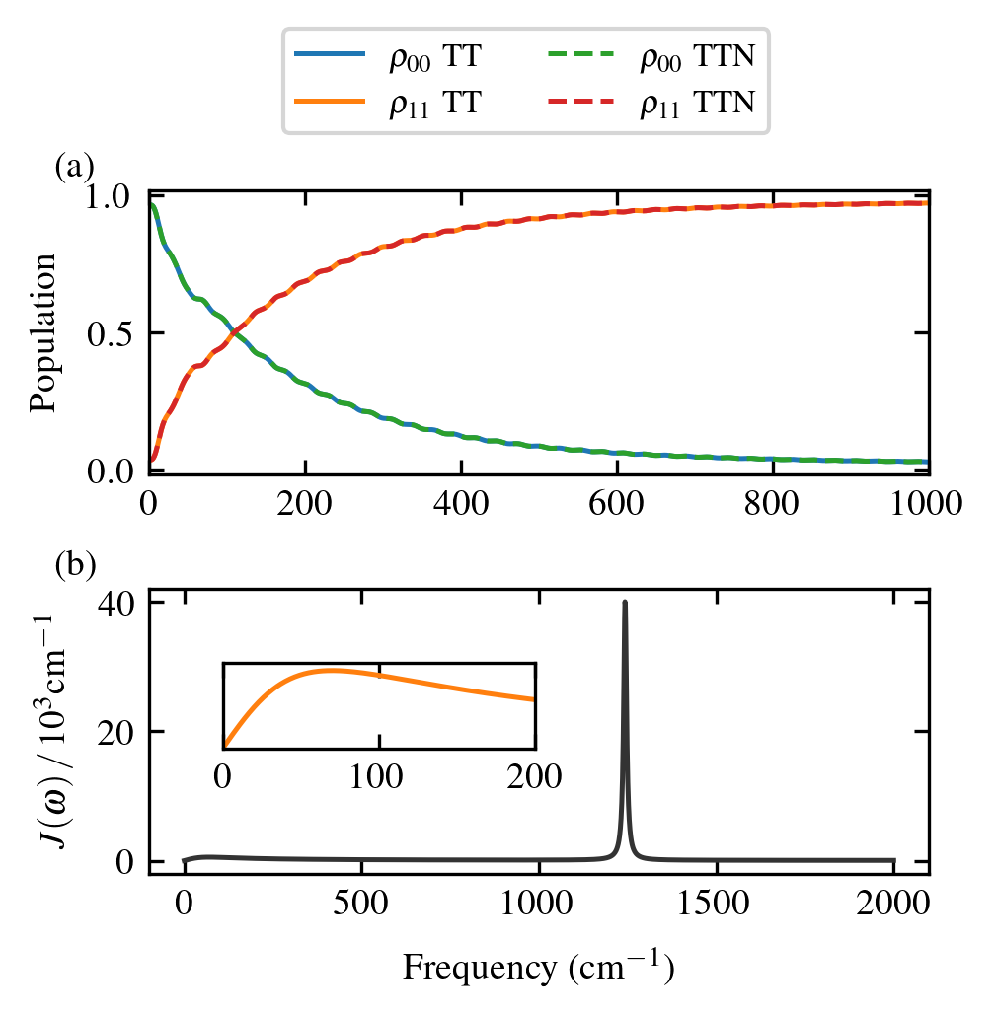
Results
Use this to graph:
You should be able to plot this; there’s no difference between Train and Tree if we use the PS2 propagation scheme. This might change if we use Direct or PS1.
import numpy as np
import matplotlib.pyplot as plt
from pathlib import Path
from mpl_toolkits.axes_grid1.inset_locator import inset_axes, mark_inset
# -------------------- EDITA ESTO --------------------
file_sb = Path("train.dat.log") # tu archivo de poblaciones SB
time_units = "fs"
pop_labels = [r"$\rho_{00}$TT", r"$\rho_{11}$TT"]
file_sb2 = Path("tree2.dat.log")
time_units = "fs"
pop_labels2 = [r"$\rho_{00}Tree$", r"$\rho_{11}$Tree"]
# Drude–Lorentz params (cm⁻¹)
re_d = [540]
width_d = [70]
# Underdamped Brownian params (cm⁻¹)
freq_b = [1243]
re_b = [161.6]
width_b = [10]
# --------------------------------------------------
plt.rcParams.update({
"text.usetex": True,
"font.family": "serif", "font.serif": ["Times"], "font.size": 9,
"axes.labelsize": 9, "axes.titlesize": 9, "axes.linewidth": 0.8,
"lines.linewidth": 1.2, "lines.markersize": 4,
"xtick.direction": "in", "ytick.direction": "in",
"xtick.top": True, "ytick.right": True,
"figure.dpi": 300,
})
def load_spinboson_pops(fname, convert_to_ps=False):
arr = np.genfromtxt(fname, dtype=complex, comments="#", skip_header=1)
t = arr[:,0].real
if convert_to_ps:
t *= 1e-3
pops = np.vstack((arr[:,1].real, arr[:,4].real)).T
return t, pops
def drude_sd(omega, re_d, width_d):
J = np.zeros_like(omega)
for lam, gamma in zip(re_d, width_d):
J += 2*lam*gamma*omega/(omega**2 + gamma**2)
return J
def brownian_sd(omega, re_b, freq_b, width_b):
J = np.zeros_like(omega)
for lam, w0, gamma in zip(re_b, freq_b, width_b):
J += 2*lam*w0**2*gamma*omega/((w0**2 - omega**2)**2 + (gamma*omega)**2)
return J
# load data
convert = (time_units.lower() == "ps")
t_sb, p_sb = load_spinboson_pops(file_sb, convert_to_ps=convert)
t_sb2, p_sb2 = load_spinboson_pops(file_sb2, convert_to_ps=convert)
# build spectral densities
omega = np.linspace(0, 2000, 2000)
J_dl = drude_sd(omega, re_d, width_d)
J_bo = brownian_sd(omega, re_b, freq_b, width_b)
J_tot = J_dl + J_bo
# make figure
fig, (ax1, ax2) = plt.subplots(
2,1, figsize=(3.4, 3.0), gridspec_kw={"hspace":0.4}
)
# --- (a) populations ---
ax1.plot(t_sb, p_sb[:,0], label=r"$\rho_{00}$ TT")
ax1.plot(t_sb, p_sb[:,1], label=r"$\rho_{11}$ TT")
ax1.plot(t_sb2, p_sb2[:,0],'--', label=r"$\rho_{00}$ TTN")
ax1.plot(t_sb2, p_sb2[:,1], '--', label=r"$\rho_{11}$ TTN")
ax1.set_ylabel("Population", labelpad=6)
#ax1.set_title(r"Spin--Boson Populations", pad=6)
ax1.set_xlim(0, 1000)
ax1.text(-0.12,1.02,"(a)", transform=ax1.transAxes,
fontsize=9, va="bottom")
# common legend for populations
handles, labs = ax1.get_legend_handles_labels()
fig.legend(handles, labs, loc="upper center",
ncol=2, bbox_to_anchor=(0.5,1.08), fontsize=8)
# --- (b) total spectral density ---
ax2.plot(omega, J_tot/1000, color="0.2", label=r"$J(\omega)$")
ax2.set_ylabel(r"$J(\omega)\,/\,10^3\mathrm{cm}^{-1}$", labelpad=6)
ax2.set_xlabel(r"Frequency (cm$^{-1}$)", labelpad=6)
#ax2.set_title("Spectral density", pad=6)
ax2.text(-0.12,1.02,"(b)", transform=ax2.transAxes,
fontsize=9, va="bottom")
# --- inset: zoom DL part ---
axins = inset_axes(ax2, width="40%", height="30%", loc="upper left", borderpad=2)
axins.plot(omega, J_dl, color="C1", linewidth=1.2)
axins.set_xlim(0, 200)
axins.set_ylim(0, J_dl[omega<=200].max()*1.1)
axins.set_xticks([0,100,200])
axins.set_yticks([])
#axins.set_title(r"Drude--Lorentz", fontsize=7, pad=3)
#mark_inset(ax2, axins, loc1=2, loc2=4, fc="none", ec="0.5")
fig.tight_layout(rect=(0,0,1,0.88))
plt.savefig("SpinBoson_populations.png", bbox_inches='tight', dpi=300, transparent=True)
plt.show()

Slide 42

Example 5: Different Propagation Schemes
Projector Splitting 1
Trotterization algorithm.
Challenging to parallelize
Fixed rank
Errors determined by split time step
Projector Splitting 2
Adaptive rank!
Trotterization algorithm. Errors determined by split time step
Two-site algorithm
Rank grows fast!
More details in: J. Chem. Phys. 163, 104109 (2025)
Direct Propagation of Master Equation for Core Tensors (in TENSO: VMF)
Admits high-order numerical propagation schemes (e.g. Runge-Kutta) and their parallelization!
Fixed rank
Requires regularization like in MCTDH (specially at early times)
Challenging for early times

Slide 43
Example 5: Different Propagation Schemes
1. Import relevant libraries as before
2. Define the name of the outputs and the propagation scheme ‘ps_method’:
propagation_1 = 'ps1' #Output name
propagation_2 = 'vmf' #Output name
outs = {
'ps1': propagation_1,
'vmf': propagation_2
}
3. Define the same BCF as in the Spin-Boson example

Slide 44
Example 5: Different Propagation Schemes
4. Propagate as before with a few key additions.
stepwise_method= ‘simple’ # changes from default propagation scheme (‘mix’) that mixes PS2 and Direct, to a single propagation scheme.
ps_method= ‘ps1’ #(options are ‘ps1’, ‘ps2’ and ‘vmf’)
#In this example, ‘ps1’ and ‘vmf’ are used. Since these methods are fixed rank, we need to specify the rank:
rank= 10
for out in outs:
propagator = spin_boson(
fname=out,
init_rdo=np.outer(wfn, wfn.conj()),
sys_ham=np.array([[1500/2, 600/2], [600/2, -1500/2]], dtype=np.complex128),
sys_op=np.array([[0.5, 0.0], [0.0, -0.5]], dtype=np.complex128),
bath_correlation=bath_simulation,
dim=5,
end_time=end_time,
step_time=dt,
stepwise_method='simple', #Changes ‘mix’ to ‘simple’
ps_method=out, # ‘ps1’ first, ‘vmf’ second
rank=10, #Constant rank along the simulation
)
progress_bar = tqdm(propagator, total=ceil(end_time / dt))
for _t in (progress_bar):
progress_bar.set_description(f'@{_t:.2f} fs')

Slide 45
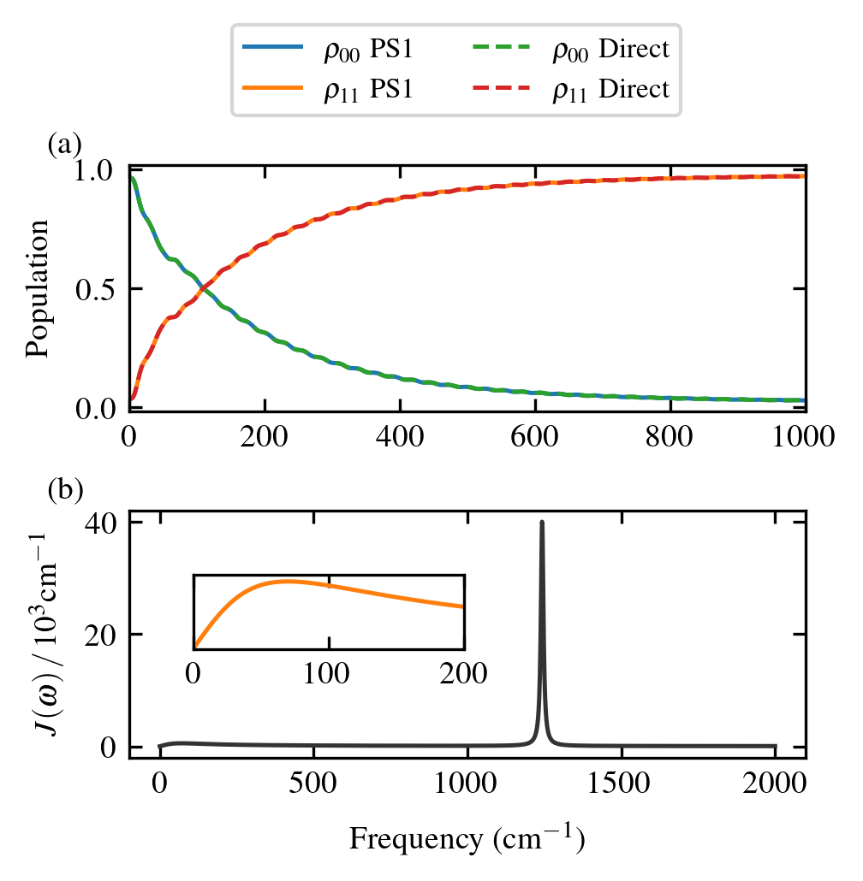
Results
Use this to graph:
No numerical difference between propagation schemes when converged
Computational time will change
import numpy as np
import matplotlib.pyplot as plt
from pathlib import Path
from mpl_toolkits.axes_grid1.inset_locator import inset_axes, mark_inset
# -------------------- EDITA ESTO --------------------
file_sb = Path("ps1.dat.log") # tu archivo de poblaciones SB
time_units = "fs"
pop_labels = [r"$\rho_{00}$TT", r"$\rho_{11}$TT"]
file_sb2 = Path("vmf.dat.log")
time_units = "fs"
pop_labels2 = [r"$\rho_{00}Tree$", r"$\rho_{11}$Tree"]
# Drude–Lorentz params (cm⁻¹)
re_d = [540]
width_d = [70]
# Underdamped Brownian params (cm⁻¹)
freq_b = [1243]
re_b = [161.6]
width_b = [10]
# --------------------------------------------------
plt.rcParams.update({
"text.usetex": True,
"font.family": "serif", "font.serif": ["Times"], "font.size": 9,
"axes.labelsize": 9, "axes.titlesize": 9, "axes.linewidth": 0.8,
"lines.linewidth": 1.2, "lines.markersize": 4,
"xtick.direction": "in", "ytick.direction": "in",
"xtick.top": True, "ytick.right": True,
"figure.dpi": 300,
})
def load_spinboson_pops(fname, convert_to_ps=False):
arr = np.genfromtxt(fname, dtype=complex, comments="#", skip_header=1)
t = arr[:,0].real
if convert_to_ps:
t *= 1e-3
pops = np.vstack((arr[:,1].real, arr[:,4].real)).T
return t, pops
def drude_sd(omega, re_d, width_d):
J = np.zeros_like(omega)
for lam, gamma in zip(re_d, width_d):
J += 2*lam*gamma*omega/(omega**2 + gamma**2)
return J
def brownian_sd(omega, re_b, freq_b, width_b):
J = np.zeros_like(omega)
for lam, w0, gamma in zip(re_b, freq_b, width_b):
J += 2*lam*w0**2*gamma*omega/((w0**2 - omega**2)**2 + (gamma*omega)**2)
return J
# load data
convert = (time_units.lower() == "ps")
t_sb, p_sb = load_spinboson_pops(file_sb, convert_to_ps=convert)
t_sb2, p_sb2 = load_spinboson_pops(file_sb2, convert_to_ps=convert)
# build spectral densities
omega = np.linspace(0, 2000, 2000)
J_dl = drude_sd(omega, re_d, width_d)
J_bo = brownian_sd(omega, re_b, freq_b, width_b)
J_tot = J_dl + J_bo
# make figure
fig, (ax1, ax2) = plt.subplots(
2,1, figsize=(3.4, 3.0), gridspec_kw={"hspace":0.4}
)
# --- (a) populations ---
ax1.plot(t_sb, p_sb[:,0], label=r"$\rho_{00}$ PS1")
ax1.plot(t_sb, p_sb[:,1], label=r"$\rho_{11}$ PS1")
ax1.plot(t_sb2, p_sb2[:,0],'--', label=r"$\rho_{00}$ Direct")
ax1.plot(t_sb2, p_sb2[:,1], '--', label=r"$\rho_{11}$ Direct")
ax1.set_ylabel("Population", labelpad=6)
#ax1.set_title(r"Spin--Boson Populations", pad=6)
ax1.set_xlim(0, 1000)
ax1.text(-0.12,1.02,"(a)", transform=ax1.transAxes,
fontsize=9, va="bottom")
# common legend for populations
handles, labs = ax1.get_legend_handles_labels()
fig.legend(handles, labs, loc="upper center",
ncol=2, bbox_to_anchor=(0.5,1.08), fontsize=8)
# --- (b) total spectral density ---
ax2.plot(omega, J_tot/1000, color="0.2", label=r"$J(\omega)$")
ax2.set_ylabel(r"$J(\omega)\,/\,10^3\mathrm{cm}^{-1}$", labelpad=6)
ax2.set_xlabel(r"Frequency (cm$^{-1}$)", labelpad=6)
#ax2.set_title("Spectral density", pad=6)
ax2.text(-0.12,1.02,"(b)", transform=ax2.transAxes,
fontsize=9, va="bottom")
# --- inset: zoom DL part ---
axins = inset_axes(ax2, width="40%", height="30%", loc="upper left", borderpad=2)
axins.plot(omega, J_dl, color="C1", linewidth=1.2)
axins.set_xlim(0, 200)
axins.set_ylim(0, J_dl[omega<=200].max()*1.1)
axins.set_xticks([0,100,200])
axins.set_yticks([])
#axins.set_title(r"Drude--Lorentz", fontsize=7, pad=3)
#mark_inset(ax2, axins, loc1=2, loc2=4, fc="none", ec="0.5")
fig.tight_layout(rect=(0,0,1,0.88))
plt.savefig("SpinBoson_populations.png", bbox_inches='tight', dpi=300, transparent=True)
plt.show()

Slide 46
Example 6: Entanglement Sudden Death
Consider a two-qubit system, where both qubits are coupled to its own bosonic bath
System Hamiltonian (cm-1):
Coupling Hamiltonians:
Spectral density:
Assume:
Initial state:
Monitor the dynamics:
Concurrence
Explore the entanglement dynamics using QuTIP’s concurrence and varying the T and gamma. Propagate up to 1000 fs with a dt=4 fs

Slide 47
Example 6: Entanglement Sudden Death
from math import ceil
import os
import json as json
import numpy as np
from tqdm import tqdm
from tenso.prototypes.heom import system_multibath
from tenso.prototypes.bath import gen_bcf
import matplotlib.pyplot as plt
#!pip install qutip #Uncoment this line if you don’t have qutip
from qutip import Qobj, concurrence
# Define Pauli matrices
sigma_x = np.array([[0, 1], [1, 0]], dtype=np.complex128)
sigma_z = np.array([[1, 0], [0, -1]], dtype=np.complex128)
I = np.eye(2, dtype=np.complex128)
# Define parameters
omega = 20
# Define single qubit Hamiltonian
H1 = (omega / 2) * sigma_z + omega/2 * I
# Construct two-qubit Hamiltonian without interaction
h = np.kron(H1, I) + np.kron(I, H1)
Q_s1=np.array([[0.0, 0.5, 0, 0], [0.5, 0.0, 0, 0],[0.0, 0, 0, 0], [0, 0.0, 0, 0]], dtype=np.complex128)
Q_s2=np.array([[0.0, 0, 0, 0], [0, 0.0, 0, 0],[0.0, 0.5, 0, 0], [0.5, 0.0, 0, 0]], dtype=np.complex128)
sys_ops = [Q_s1,Q_s2] #The system Hamiltonian is sigma_z for both qubits
rdo_0 = np.array([[0, 0, 0, 0],
[0, 0.5, -0.5, 0],
[0, -0.5, 0.5,0],
[0, 0, 0,0]],
dtype=np.complex128) #This is the initial state of the two-qubit system

Slide 48
Example 6: Entanglement Sudden Death
TT=[100,200,300,400]
end_time = 200.0
dt= 4
for T in TT:
print("T_%dK begins" % T)
bath = gen_bcf(
re_d=[50],
width_d=[5],
temperature=T,
decomposition_method='Pade',
n_ltc=1,
)
out = "T_%dK" % T
propagator = system_multibath(
fname=out,
init_rdo=rdo_0,
sys_ham=h,
sys_ops=sys_ops,
bath_correlations=[bath] * 2,
end_time=end_time,
step_time=dt,
dim=20
)
progress_bar = tqdm(propagator, total=ceil(end_time / dt))
for _t in (progress_bar):
progress_bar.set_description(f'@{_t:.2f} fs')
print("T_%dK is completed" % T)

Slide 49
fig=plt.figure(dpi=300,figsize=(3, 2))
TT=[100,200,300,400]
for T in TT[::-1]:
current_dir = os.getcwd()
log_path = os.path.join(current_dir, "T_%dK.dat.log" % T)
data=np.loadtxt(log_path,dtype=complex)
cct=[]
t=[]
for i in range(data.shape[0]):
rho_t=np.array([[data[i][1],data[i][2],data[i][3],data[i][4]],
[data[i][5],data[i][6],data[i][7],data[i][8]],
[data[i][9],data[i][10],data[i][11],data[i][12]],
[data[i][13],data[i][14],data[i][15],data[i][16]]])
Ct = concurrence(Qobj(rho_t, dims=[[2, 2], [2, 2]]))
cct.append(Ct)
t.append(data[i][0])
plt.plot(t,cct,label="T=%dK" % T)
plt.rcParams.update({
"font.size": 4,
"axes.titlesize": 6,
"axes.labelsize": 6,
"xtick.labelsize": 5,
"ytick.labelsize": 5,
"legend.fontsize": 5,
"figure.titlesize": 7
})
plt.xlabel("Time (fs)")
plt.ylabel("Concurrence")
plt.legend()
plt.show()

Slide 50
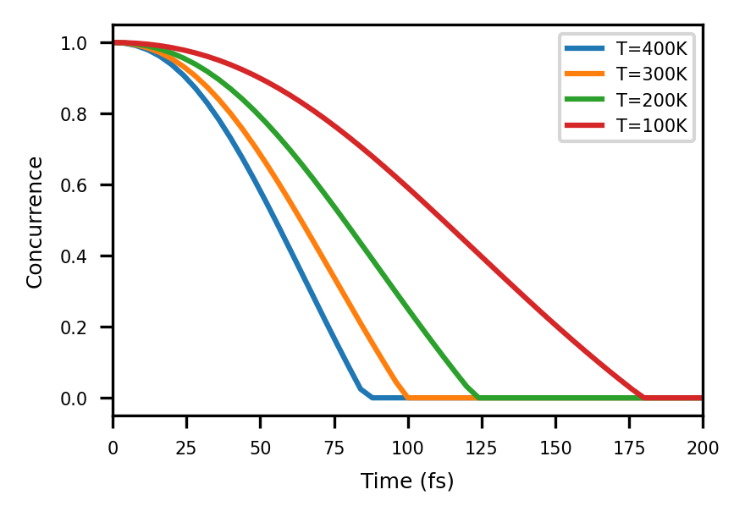
Example 6: Entanglement Sudden Death

Slide 51
Other features (ask Juan and Michelle!)
Change standard TENSO units
Define your own decomposition of the BCF
Define your own HEOM variant by varying metric and bexcitonic representation
Define your own tensor network
Run MCTDH and TEDOPA
Run your own dynamics with a generator that is a sum of products

Slide 52
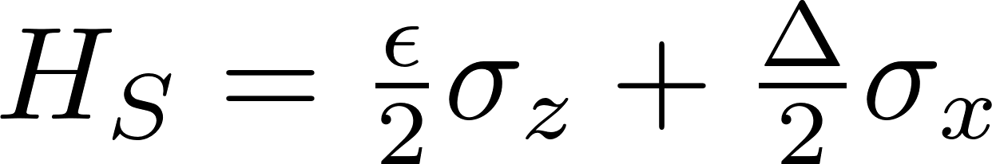
Exercise 1: Convergence with HEOM depth
Consider a two-level system (qubit) coupled to a 300 K bosonic environment
System Hamiltonian:
Coupling Hamiltonian:
Spectral density:
Assume:
Initial state:
Monitor the dynamics: Population inversion
Coherence magnitude
What HEOM depth (dim) is needed for convergence?

Slide 53
Exercise 2: Convergence with Low T Corrections
Consider a two-level system (qubit) coupled to a 100 K bosonic environment
System Hamiltonian:
Coupling Hamiltonian:
Spectral density:
Assume:
Initial state:
Monitor the dynamics: Population inversion
Coherence magnitude
How many Low Temperature corrections do you need for convergence?
Hint: With a DL environment no coherence revivals are expected

Slide 54
Exercise 3: 3-site FMO
Consider the {|0>, |1>, |2>} subsystem in the FMO Hamiltonian (provided below in cm-1). Create a TENSO input for this system
System Hamiltonian (cm-1):
Coupling Hamiltonians:
Spectral density:
Assume:
Initial state:
Monitor the dynamics:
Site populations up to 1ps
How many Low Temperature corrections do you need for convergence at 300K?, what about 77K?
Hint: You need three equivalent baths, one per site.

